Slide 1








Engaging Minds:
ELT Approaches for Young Learners
Speaker: Katherine Reilly
Author and Teacher Trainer

Slide 2



TABLE OF CONTENTS
01
02
03
04
Total Physical Response
Play-Based Learning
Linking Language with Physical Movement
Encouraging Natural Language Use
Sensory Play
Realia
Engaging Senses in Vocabulary Acquisition
Tangible Learning

Slide 3


What is Total Physical Response?
TPR is a language teaching method that combines language learning with physical movement.
Developed by James Asher in the 1960s.
Effective with teaching vocabulary and simple sentence structure formation.

Slide 4
What are the key concepts of TPR?
Language Acquisition via listening and responding physically instead of verbally.
Stress-free environment
Reinforces comprehension and retention

Slide 5
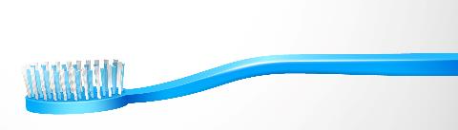




TPR Activities
1. Basic Commands
2. Daily Routines
Body Parts
Classroom Objects
Basic Actions
Classroom Routine
Morning Routine

Slide 6
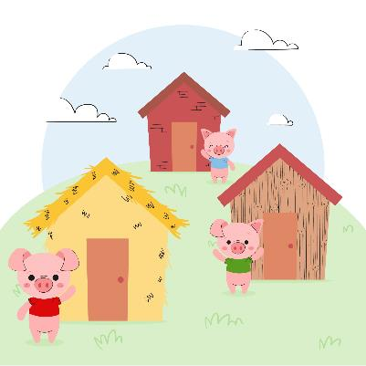
TPR Activities
3. Storytelling with Actions
The Three Little Pigs:
Pretend to build a house with various materials (students mimic building)
Association of visuals and actions with vocabulary (axe, chop wood, carry etc.)
AI Image generated by Freepik

Slide 7


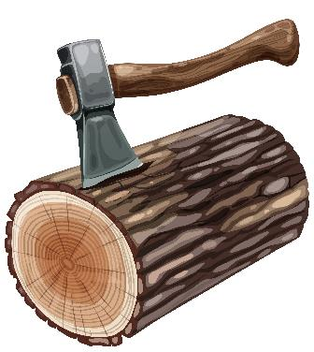

Image by luis_molinero
Image by Catalyststuff
AI Image generated by Freepik
Image by brgfx

Slide 8
TPR Activities
4. Songs with Actions
‘Who’s afraid of the Big Bad Wolf?’
Action: Students can express fear or courage (e.g. brave, scared)
They mimic actions such as blowing or running
They skip and dance and feel entertained
AI Image generated by Freepik

Slide 9
TPR Activities
5. Directions and Movement
6. Interactive Activities
Turn left
Jump forward
Take two steps
Find something blue
Can you see anything that starts with the letter ‘B’?
Sth that can open and close

Slide 10
Taking it to the next level
Prepositions e.g. “Put the book on the table” “Place the pencil under your chair”
Sequence Activities e.g. “First walk to the door, then open it, and finally wave to the class”

Slide 11
What is Play-Based Learning?
PBL is an educational approach that uses play as a medium for children to explore, learn, and practice new skills.
Structured and Unstructured play can be particularly effective in promoting language use.

Slide 12

Isn’t this the same as Gamification?
Gamification has pre-determined objectives by honing a specific skill incorporating challenges, points and rewards.
PBL encourages initiatives, expression and abstract engagement with the language

Slide 13
Structured and Unstructured Play
Structured play helps children learn specific skills in a guided environment
Unstructured play encourages creativity, exploration, and social development

Slide 14
Key Differences
Structured: Adult-Guided, teaches specific skills and concepts
Unstructured: Child-led, no predetermined goals, focus on development via exploration adapting to various needs, interests and pace

Slide 15
PBL Activities
1. Structured
RPG Imaginary Settings (restaurant, supermarket et al.)
Storytime with props (puppets, costumes)
2. Unstructured
Total Physical Response
Free RPG Imaginary Settings
Construction Play

Slide 16
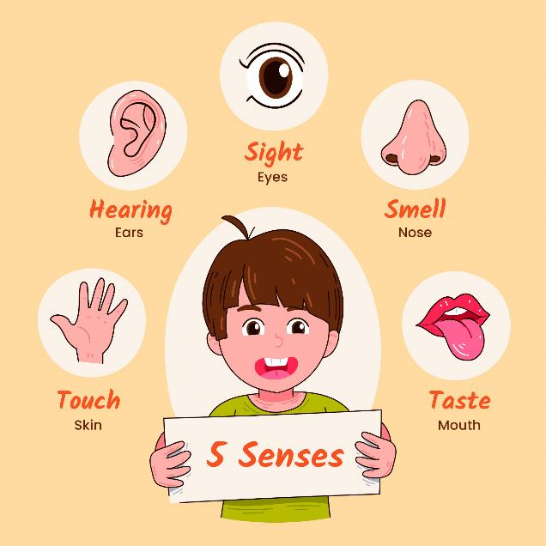
What are the five Senses?
AI Image generated by Freepik

Slide 17

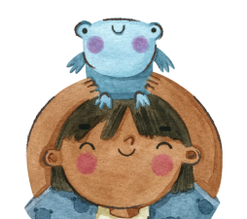


Sensory Play
SP is a teaching strategy that engages multiple senses: sight, sound, touch, taste, and smell via learning activities, connecting words to sensory experiences
Notes:
can

Slide 18
Sensory Play
This approach enhances understanding and retention of new vocabulary words
Notes:
can

Slide 19
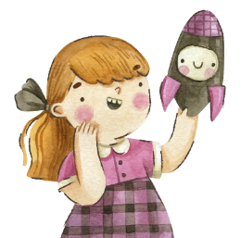

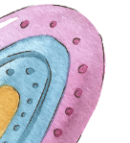
So… How does it Work?
Engaging one or more senses helps reinforce the meaning of words.
For example, if a child is learning the word "rough," they might touch a sandpaper surface, which makes the word more concrete and memorable.

Slide 20
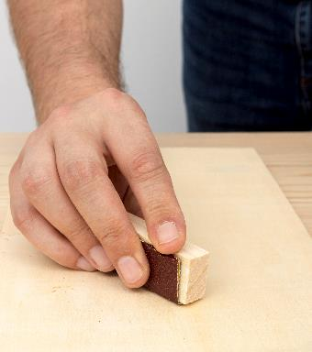


All Images generated by Freepik
Sandpaper

Slide 21
Sensory Play – Vocabulary Acquisition
Textured Objects | Smooth, rough, soft hard, bumpy |  | Scented Words | Citrus, refreshing
Senses Engaged | Touch, sight |  | Senses Engaged | Smell, sight
Taste & Description | Sweet, sour, salty, bitter |  | Sound & Description | Ring, tap, screech
Senses Engaged | Taste, touch |  | Senses Engaged | Hearing

Slide 22

So… Isn’t Total Physical Response the same as Sensory Play?
TPR focuses on language acquisition through physical movement, while sensory play focuses on exploring and developing sensory experiences and motor skills
Soft (adj.)
Tickle (v.)
Image by rawpixel on Freepik

Slide 23
Realia for Tangible Learning
Realia refers to real-life objects used in the classroom to make learning more concrete and engaging
Caters to various learning styles, particularly kinesthetic learners

Slide 24

Where can it be used?
Vocabulary Building (e.g. classroom objects, groceries)
Cultural Awareness (e.g. currency, postcards, clothing)
Shopping Scenarios and Travelling
Countable and Uncountable Nouns
Demonstrations (e.g. gadgets, cooking)

Slide 25
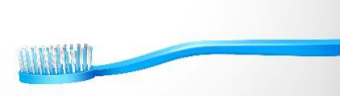
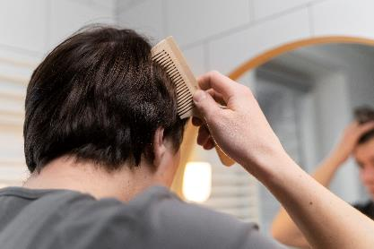

Realia for Tangible Learning
Image by Freepik
Image by benzoix on Freepik

Slide 26
So… Isn’t Realia the same as Sensory Play?
BOTH involve interaction, but…
realia is about using objects to teach language directly,
while sensory play via touch is about exploring textures and sensations, with the language acting as a means to express their feelings and experience.

Slide 27
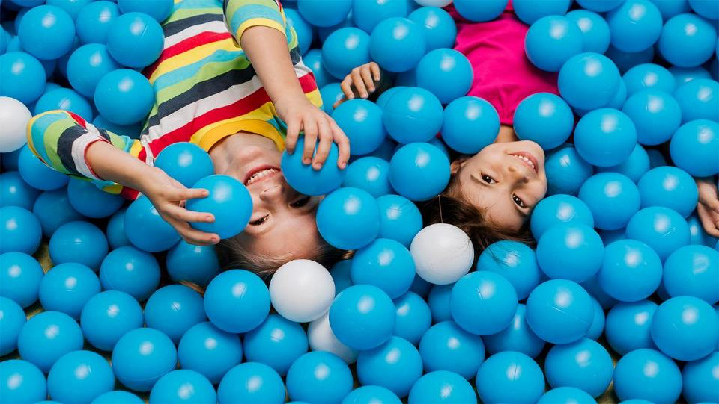
EXPERIMENT - COMBINE - REPEAT

Slide 28
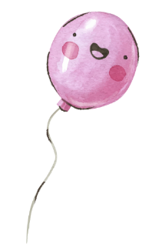





THANKS!
Does anyone have any questions?
katherinereilly1@yahoo.com
katherinereilly.blog
FOLLOW ME ON SOCIAL MEDIA:

