Slide 1









Gamification in Grammar, Make Learning Fun for Everyone
Speaker:
Katherine Reilly
Author & Academic Lecturer, English Literature |
LGBTQIA+ Business Consultant

Slide 2

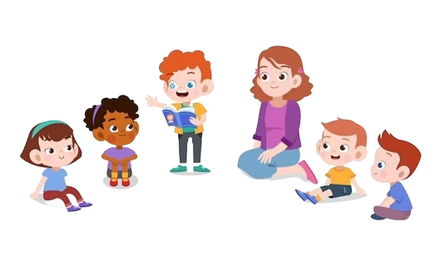

What is Gamification?
According to the Cambridge Dictionary:
“Gamification is 'the practice of making activities more like games in order to make them more interesting or enjoyable.”

Slide 3
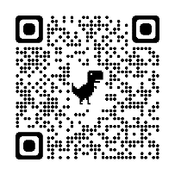
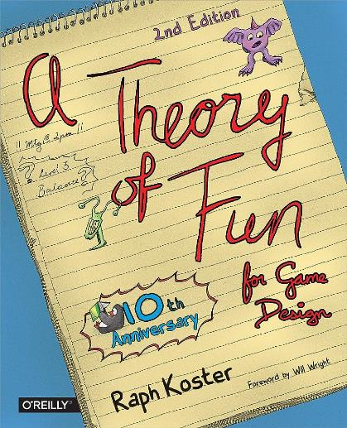
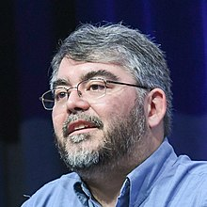
Let’s Make Something Clear…
Games and Gamification are Different Terms
According to Koster:
“Games are systems built to help us learn patterns.”
“Fun is a neurochemical reward to encourage us to keep trying.”
Koster, R. (2013). Theory of fun for game design. ” O’Reilly Media, Inc.”.

Slide 4


Then What Exactly is ‘Gamification’ ?
It is an Educational Approach to Motivating students to learn by using game elements in non-gaming environments.
Set objectives (quests) to meet your outcomes.
Reward students (players) with badges, points, trophies.

Slide 5

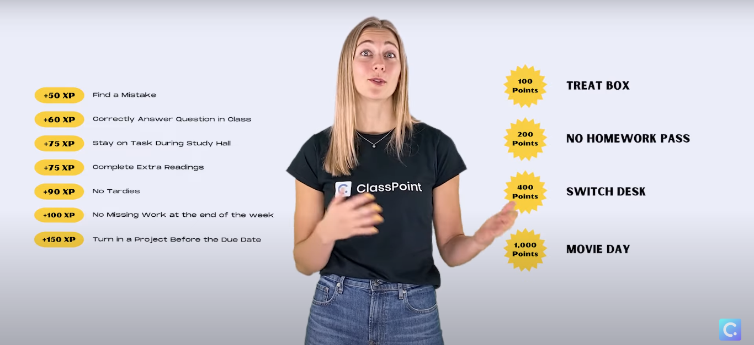

Slide 6
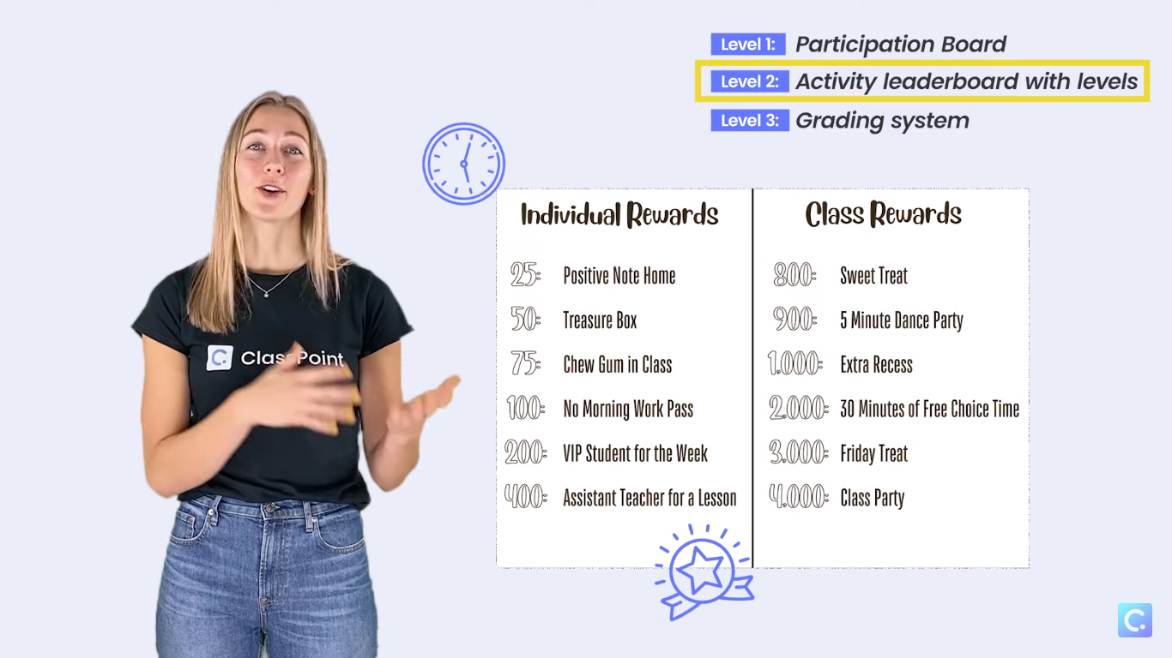

Slide 7
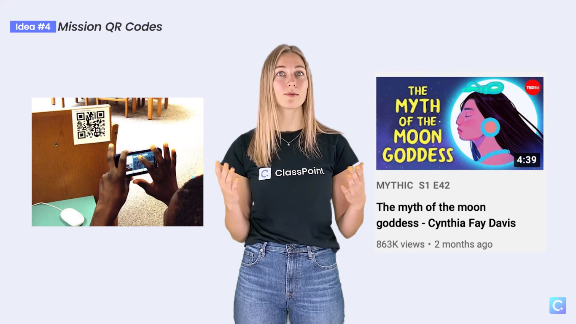

Slide 8





What Types of Gamification will we Examine?
Non-Technological
Verbal
Text-Based
Materials-Based
Technological
Applications (Teaching Assistants)
AI Integrated
Hybrid (e.g.)
Board Games
Detection & Recognition

Slide 9

When Creating Your Own Games
Bear in Mind…
Factors
Genre or Platform
Reward and Incentive
Challenge
Levels and Difficulty
Grammar Focus
21st Century Skills

Slide 10

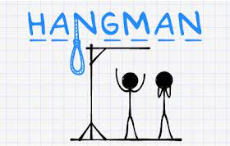
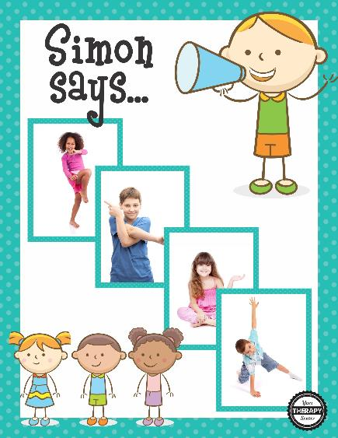
Games have always been a staple
Some games are vocabulary driven
Others can be enhanced to promote grammar consolidation (tenses, prepositions, pronouns)
“Simon says dance.”
“Simon says, dance with the person next to you.”

Slide 11
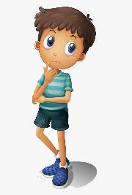

Sentence Building with Flashcards
Using Visual Stimuli
Two students take turns
One student chooses the cards while the other compiles a sentence with no mistakes
The teacher keeps score
The game can be enhanced with an additional noun card further increasing the difficulty
NOUN card + VERB card + NOUN CARD
e.g. The boy is playing basketball.
PLAY

Slide 12


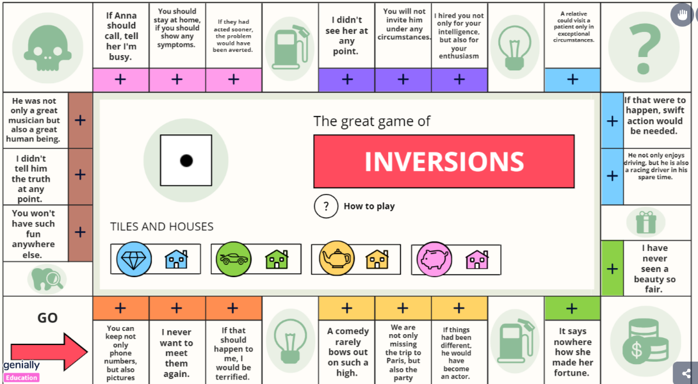
Interactive Board Games
“Inversions”
Genially Platform
Monopoly Inspired Board Games
Easy to edit
Create a completely new game in no time
Free Content

Slide 13


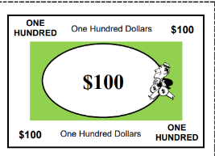
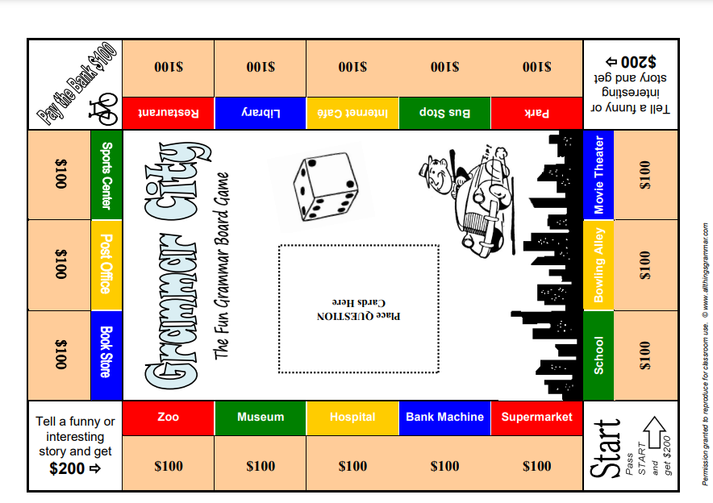
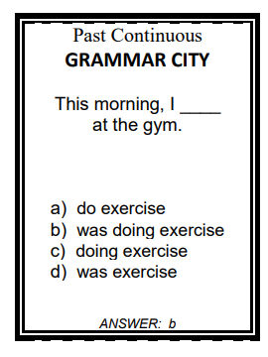

Printable Board Games
“Grammar City”
allthingsgrammar
A4 printable
Huge variety of cards based on grammar
Create your own cards
Free to download

Slide 14


Interactive Learning Platforms
Interactive presentations
Word clouds
Open ended questions
Option to vote unique or inspiring responses

Slide 15



Interactive Learning Platforms
Live Quiz with indicators on board displaying students’ progress
Optional ‘redemption questions’ to offer students a second attempt if they miss a question
Paper QR code printout if the students don’t have devices
Integration of Videos in Quiz

Slide 16


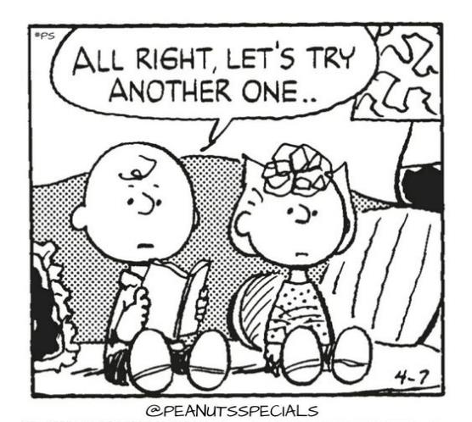
Interactive Learning Platforms
Similar Learning Platform
Each platform offers various options
Free materials and/or prices vary

Slide 17

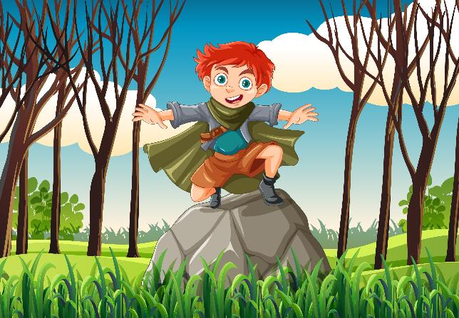
Story-led Gamification for Teaching Grammar
Create an Engaging Storyline (e.g. medieval fantasy)
Integrate Grammar Challenges
Multiplayer Features (e.g. cooperative quests or ‘grammar duels’)
Progressive Difficulty Levels
Reward System
Guidance and Feedback
Personalization and Adaptivity
Syntax Stone
NO TIME TO PREPARE?

Slide 18


AI Created Comics for Grammar Enhancement
Create a comic via AI, tailored to your students’ educational needs and preferences
Google Search: ‘AI Comic Creator’
Enter the description: "A pirate on a spaceship lands on Mars”
Offer the AI key words e.g. colorful, playful, funny
AI Generated Image by Freepik.com

Slide 19
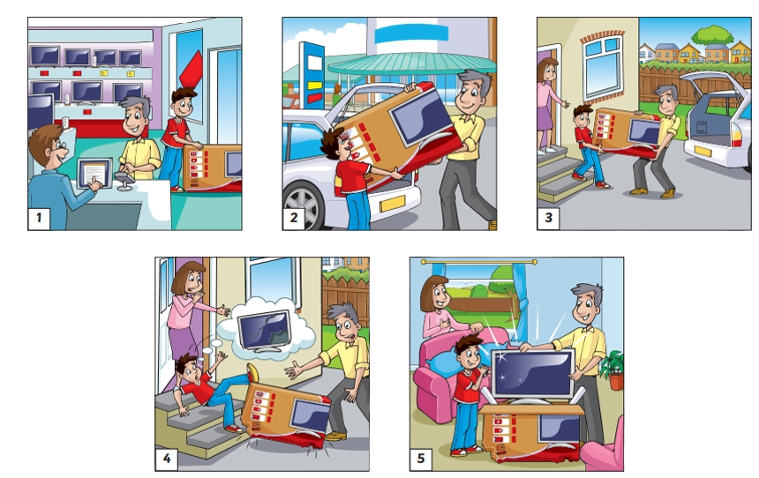

Narrating a Story
Using Visual Stimuli
The Teacher sets rules (e.g. use at least 2 adjectives per panel, use an imperative, etc.
Role play can also be implemented
Have each group act the story in a different way
Funny interactions

Slide 20
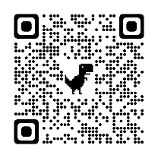
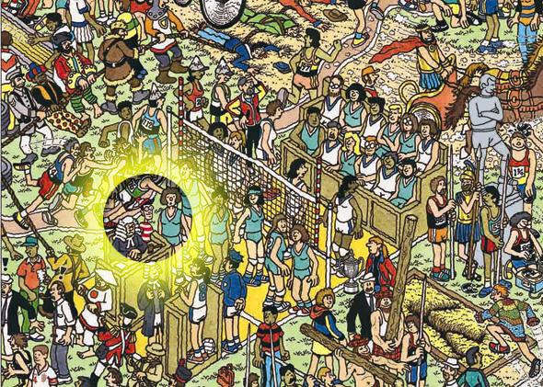
Children’s Puzzle Books
“Where’s Waldo?”
Honing skills
Detection & Recognition
Grammar Practice
  Describing an Action
  Designating a Location
Variations
Traveling
Space
Holidays (e.g. Christmas)

Slide 21
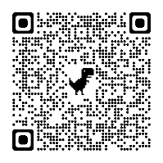
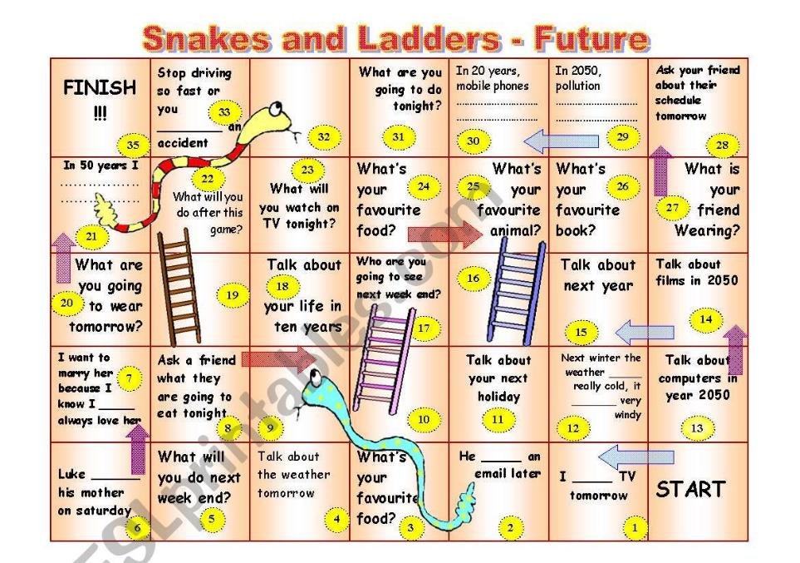
Printable Worksheets
(also for use on Whiteboard)
Register (for free) and contribute materials to ELT Websites
Huge varieties which can be tailored to the lesson
Split students in groups of four with an A4 or better yet A3 printout
Display it on the board

Slide 22
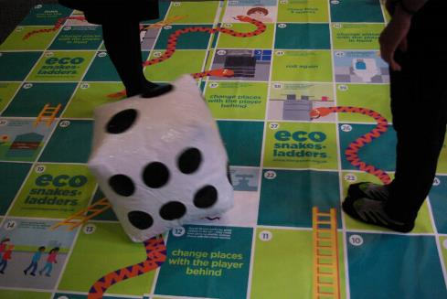
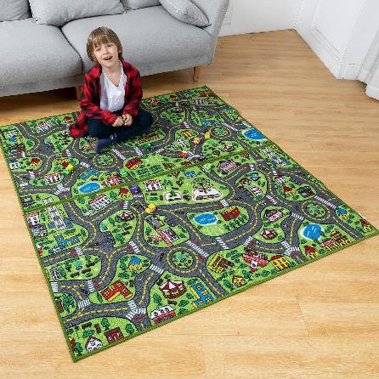
Carpet Games & Playmats
Snakes & Ladders with Grammar Questions
Navigate Through the City with proper grammar directions
Teacher splits students into two rivalry groups.
In turns, one student of each pair gives directions to partner to reach a destination
Teacher offers a point when a student delivers correct instructions and another point for following the instructions correctly.
Demands a financial Investment (use image on whiteboard instead)

Slide 23

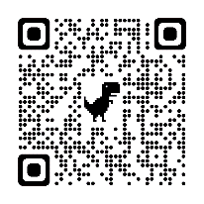


Word Search Makers –
Puzzle Makers
Control the content of the puzzle
Have students search, assess and categorize words
e.g. ‘circle 10 nouns’, ‘circle five positive adjectives’, ‘circle ALL words and color the verbs’
Have them justify their decision

Slide 24






Thank you!!!
Special Thanks:
Find me on:
Email:
katherinereilly1@yahoo.com
Educational Blog:
katherinereilly.blog
ELT YouTube Channel:
youtube.com/c/katherinereillyauthor
References:
https://worldofelt.com/2020/03/02/gamification-in-the-language-classroom/
https://www.cambridgeenglish.org/teaching-english/resources-for-teachers/kahoot/
Materials:
https://youtu.be/-UXsuofrUdk Classpoint Video
https://view.genial.ly/627cd40567bf2f0011d35fe7/interactive-content-inversions
https://www.allthingsgrammar.com/grammar-city-free-grammar-board-game.html
https://www.mentimeter.com/app/home
https://quizizz.com/admin/quiz/5d535e853c3272001a04bf18?source=quiz_share
https://www.eslprintables.com/
https://create.kahoot.it/details/7902fb5c-71c8-4689-9a10-391e0a273327
https://tools.atozteacherstuff.com/word-search-maker/wordsearch.php
https://puzzlemaker.discoveryeducation.com/
Enchanted stone: Image by brgfx on Freepik
AI logo by rawpixel.com on Freepik

