Slide 1




Transversal Competency in the ELT Environment
Plenary Speaker:
Katherine Reilly
Author & Educator

Slide 2
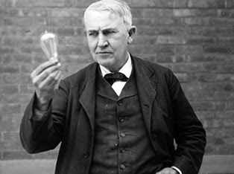

Rectifying a Question…
When was the first light bulb invented and by whom?
Why was the invention of the lightbulb the greatest innovation in history?
helped to establish social order after sundown
extended the workday well into the night
allowed us to navigate and travel safely in the dark.
Thomas Edison 1879

Slide 3
Why do today’s students find it difficult to produce ideas?
Despite the excellent command of the language, they lack, adhere to, or suffer from the following:
Social/Peer Judgment
Rote Learning
Inability or fear to doubt a source
Too much emphasis on Grammar and Vocabulary
Critical Thinking is not fostered in schools

Slide 4

Did you know…
By 2030, an estimated 825 million children are expected to leave school without basic secondary level skills.
39% of employers in nine diverse countries (including high income countries) claim that a leading reason for entry level vacancies in diverse economies is due in part to a skills shortage.
Across the globe, about 500 million youth are unemployed, underemployed or working insecure jobs, often in the informal sector.
255 million (21%) youth in the developing world—three quarters of them women—are not in employment, education or training.
Over 33% of students between the ages of 13 and 15 experience bullying from their peers.
Source: UNICEF Education Centre Framework

Slide 5
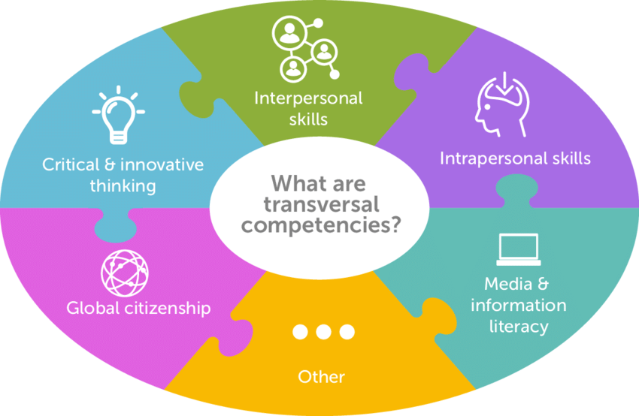
Our Obligation as Educators
To Equip Students with the Right Competencies
Skills
Knowledge
Values
Attitudes
Well-being & Faith
Photo Credits: UNESCO Assessment

Slide 6

How about another example?
Essay Topic: Is Plastic Surgery a Necessity?
Brainstorming
Against:
We should accept ourselves for who we are
If further promotes our insecurities
Waste of money
Potential Health Risks

Slide 7

How about another example?
Essay Topic: Is Plastic Surgery a Necessity?
Brainstorming
In Favor:
Social Acceptance
Mental Health
Burn Victims
Health Issues

Slide 8
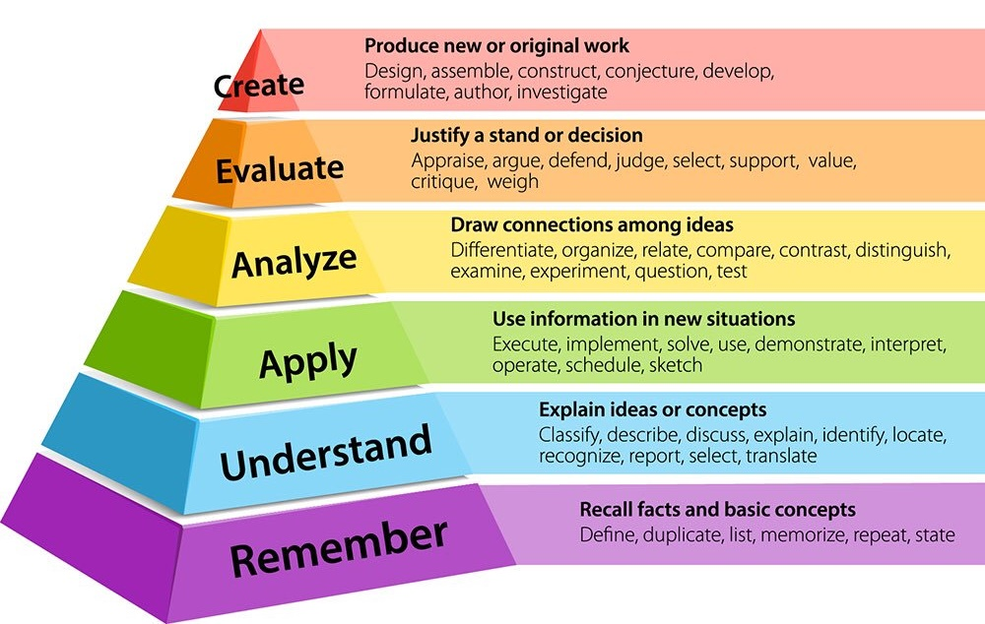
The ELT Critical Thinking Model
Bloom’s Taxonomy
Bloom's taxonomy is a classification system used to define and distinguish different levels of human cognition e.g. thinking, learning, and understanding.

Slide 9

The ELT Critical Thinking Model
Knowledge
Comprehension
Application
Analysis
Synthesis
Evaluation

Slide 10

Can Critical Thinking be Taught,
or is it an Innate Ability?
Not only can critical thinking be taught, it can be practiced and refined!
As with all skills, Critical Thinking must be fostered and enhanced
Subsequently, a student will adopt it as a learning approach in class
  Grammar
  Vocabulary
  Receptive Skills (Reading & Listening)
  Productive Skills (Speaking & Writing)

Slide 11
Example: Reading Segment
Knowledge
Comprehension
Application
Analysis
Synthesis
Evaluation
Young Inventor
Schoolboy Tim Freeman has come up with a clear idea to improve the efficiency of school buses.
Tim Freeman was just twelve years old when he came up with a revolutionary idea that would make school buses more energy efficient. This would not only save money, but also help the environment. Five years later, the schoolboy finally saw his dream come true.
Source: Cambridge FCE Sample Paper

Slide 12
Application of CT in the ELT Environment
Where can I find the proper ELT material to stimulate CT in class?
  ELT Coursebooks that have embedded the CT element
  Valid Online Resources careful of scammers!
  Create your own material!

Slide 13
Wait a second…
When is the best time to start using the CT Model?
Critical thinking must be fostered from the get go
Junior Classes are ideal for this
There must be a constant increase in difficulty as students adapt
The concept is to keep them on their toes and provide new challenges

Slide 14
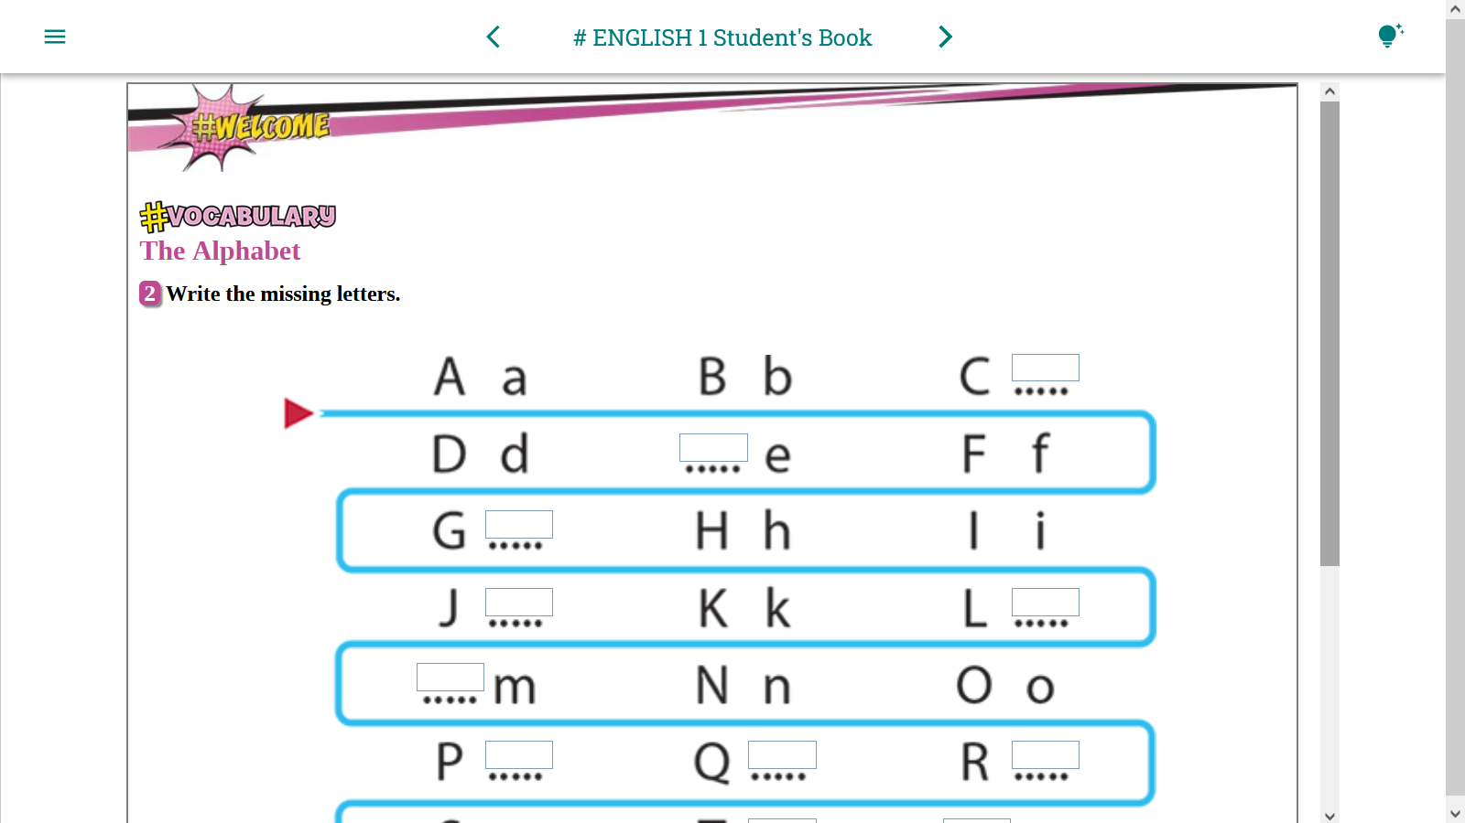
c

Slide 15
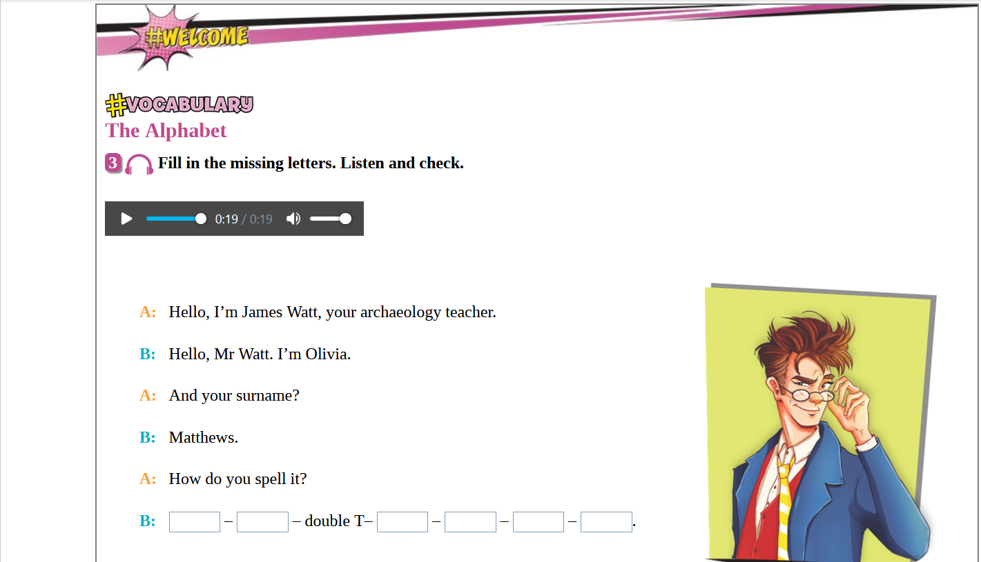
Focus via TWO receptive skills
  Listening
  Reading
Utilization of Visual Stimulation
Ignition of Critical Thinking
Implementation via Productive Skill
  Writing
M A H E W S

Slide 16
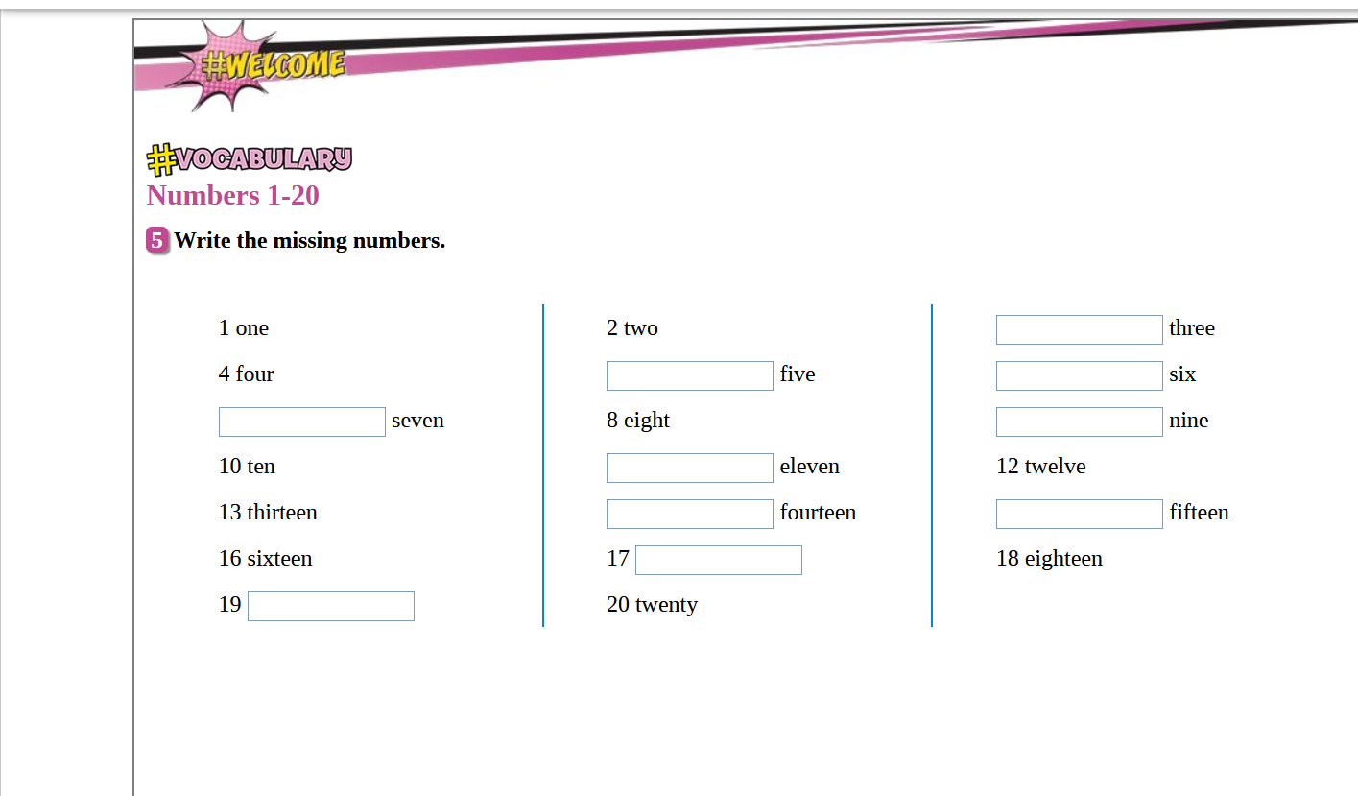
Missing Digit
Missing Word
ALL NUMBERS

Slide 17
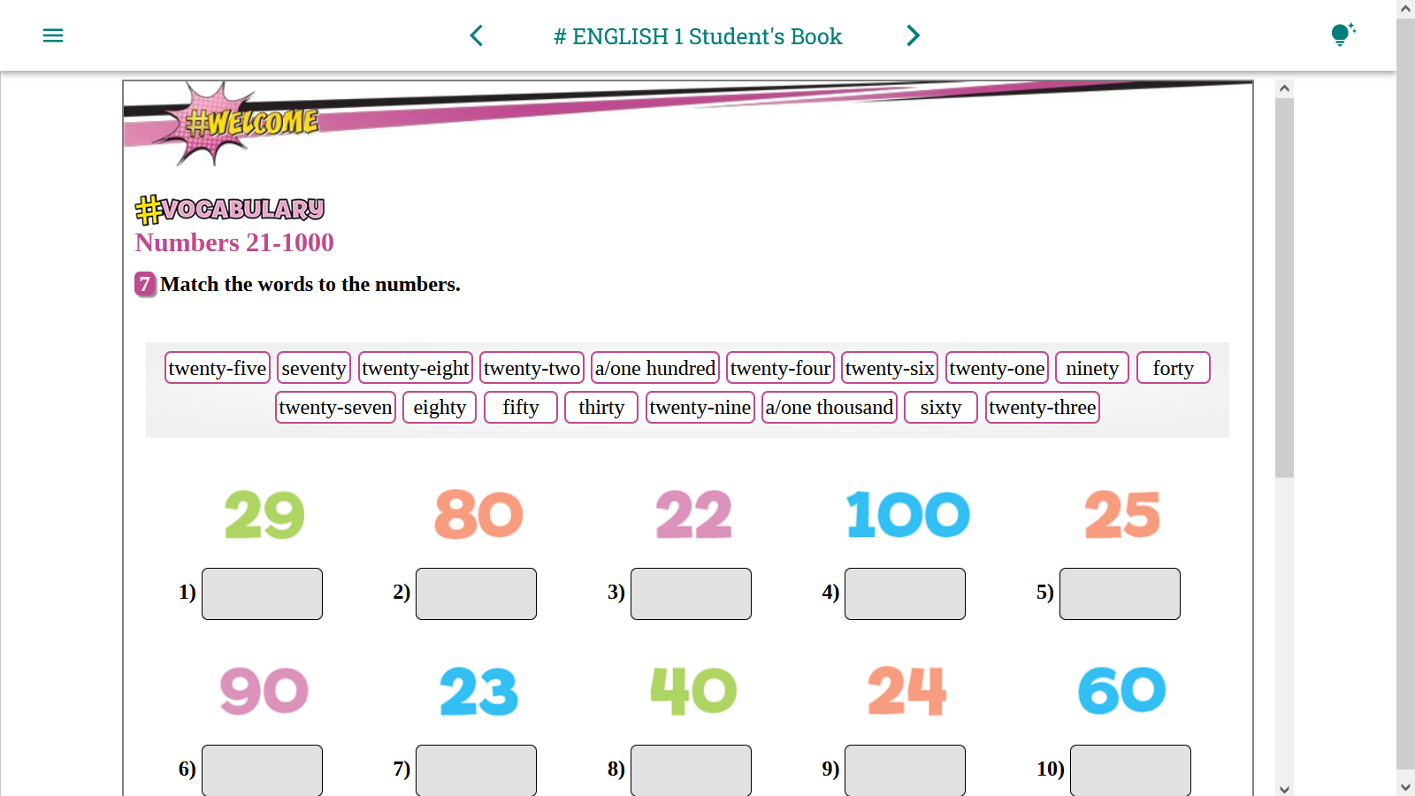
Offer them a challenge!
  Mix the order!

Slide 18
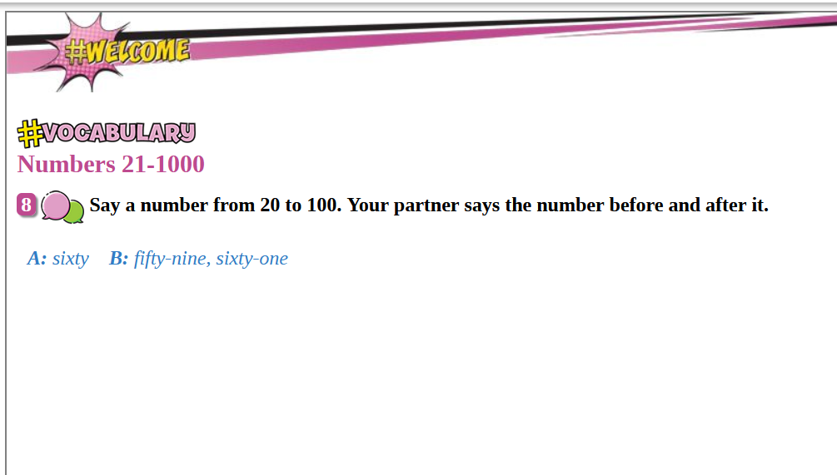
Have them scratch their Heads!
  Entertaining
  Thought Provoking
  Sharpens their Responsive Skills

Slide 19
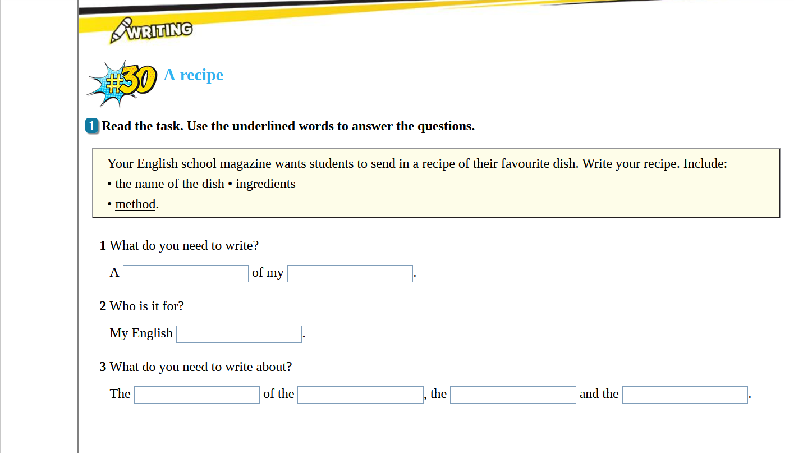
Students fail exams as they neglect to read the task!

Slide 20
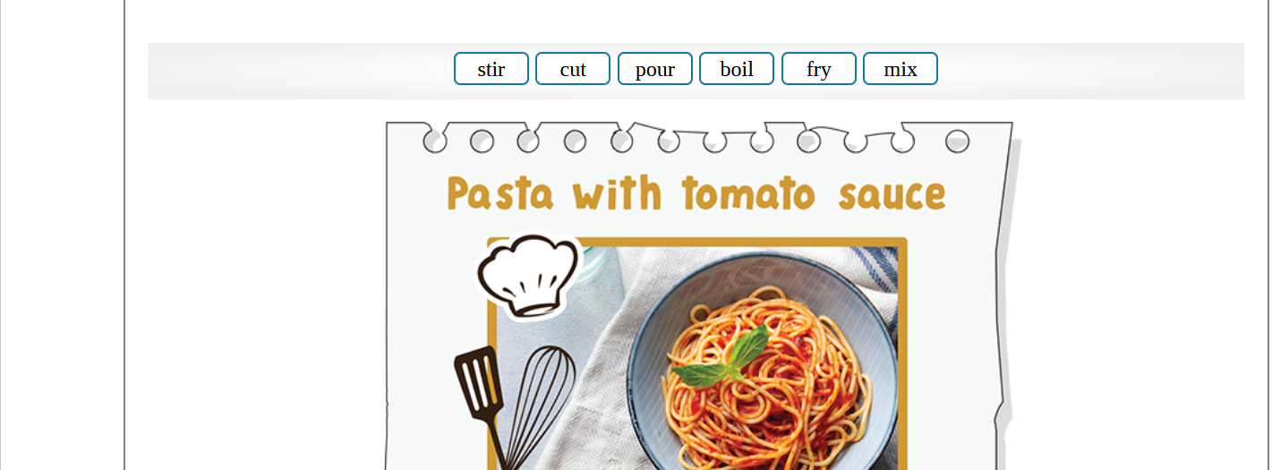
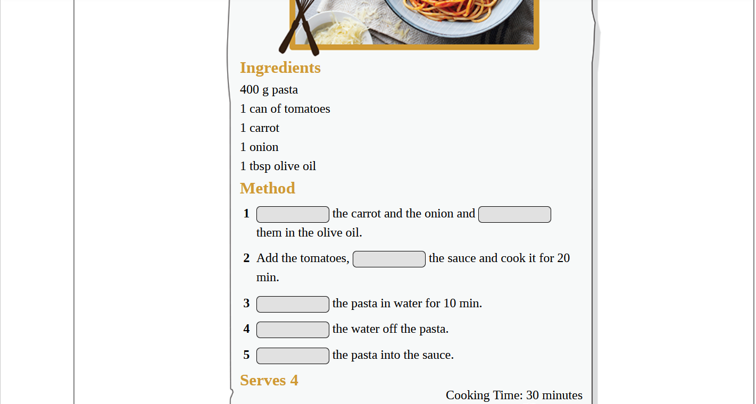

Slide 22
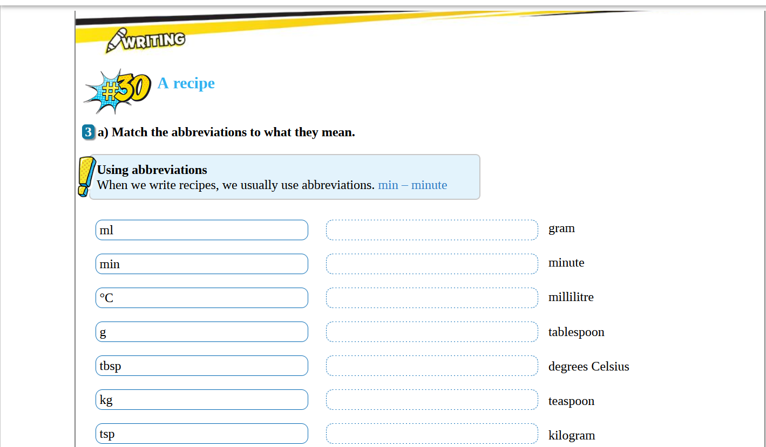

Slide 23
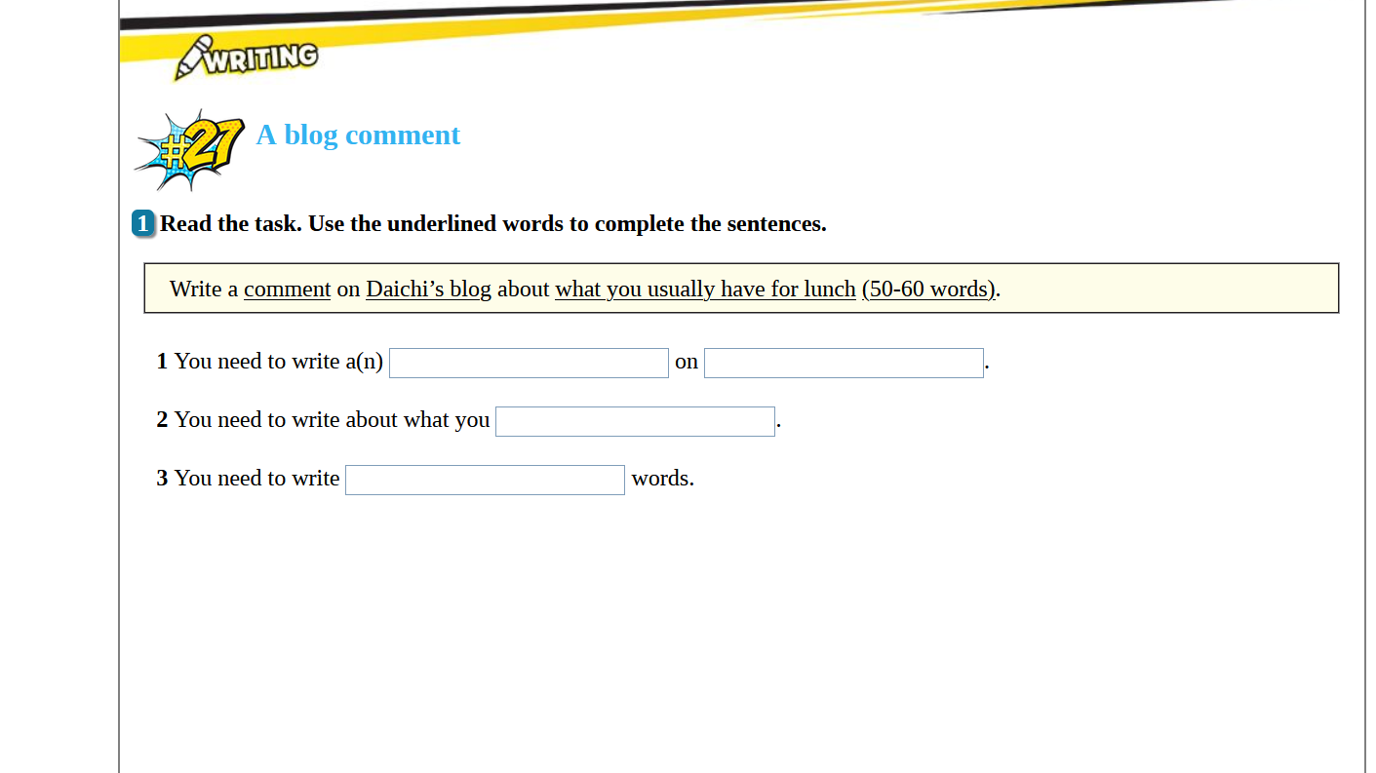
Task Example 1
Students start adapting
  Focus on task prerequisites

Slide 24
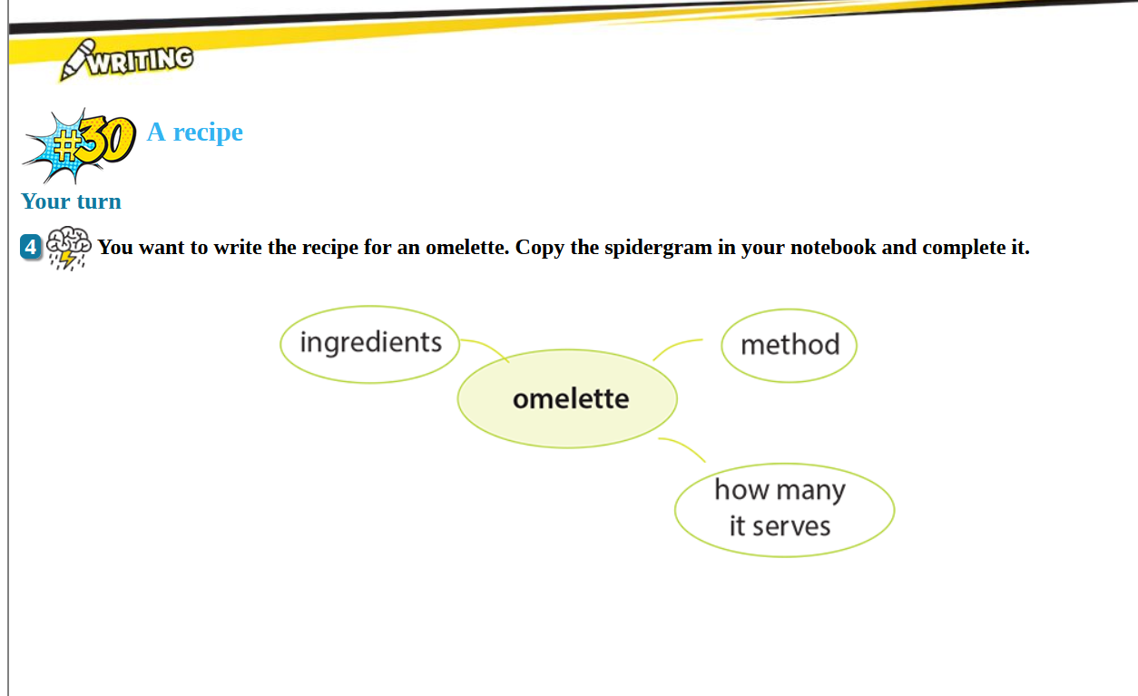
The Student Acknowledges and Sets CLEAR GOALS
Task Example 2
Offer Receptive Alternatives
  We ALL process information in various ways
  Visual, Audio, Kinetic, Combination

Slide 25
Critical Thinking Activities
What about students who have had little to no stimulation in Critical Thought?
Let’s try some simple approaches…

Slide 26

Critical Thinking Activities
Essay Topic: Does Alcohol Always Create Problems?
1. Ask Questions – Inspire Critical Thought
What role can the government play?
Should we completely abolish alcohol?
Why do people become addicted?
How much is too much?

Slide 27

Critical Thinking Activities
2. Open Ended Questions – There is no right answer
How do you feel about this issue?
What is the greatest challenge an alcoholic faces?
What would you do to help someone struggling?
Avoid Yes/No questions at all costs!

Slide 28

Critical Thinking Activities
3. Allowance of Time to Think
Discourage them from answering on the spot:
  Fluency and Impulsive answers are not always thought out extensively
  The Combination of Fluency and CT will eventually entail

Slide 29

Critical Thinking Activities
4. Requesting further Elaboration
Can you please elaborate?
Would you mind offering more information?
Why wouldn’t you support the other opinion?
You haven’t convinced me with your claims. Is there anything else you wish to share?

Slide 30

Critical Thinking Activities
5. Providing Scaffolds
Offer hints and clues
Provide examples
Have your students split into teams
Assign Tasks
Make comparisons
Encourage debates →

Slide 31

Critical Thinking Activities
6. Encouraging Debates
Debates foster the capacity to make an argument and support one’s opinion
Encourage students to express logical and reasonable supports for their opinions
HIGHLY beneficial for writing tasks

Slide 32


Critical Thinking Activities
7. Making Predictions
Predicting content based on the title of a Passage
Pausing an audio or video segment
Accompanying imagery in textbooks

Slide 33
Critical Thinking Activities
8. Controversial Statements
Thinking about both sides of an argument
Challenge students to list reasons in support of a statement as well as against it
Teach them how to write a refutation for writing tasks

Slide 34
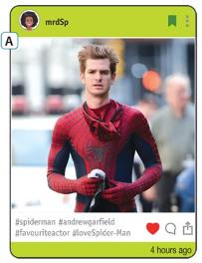

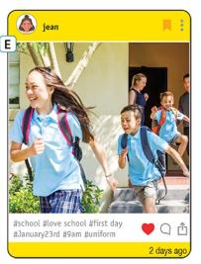
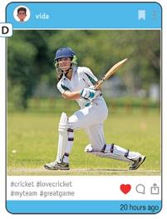

Collaborative Activities
Fostering Interpersonal Skills
Pair or Group Discussions
  Listening Triangles (speaker, questioner and a note-taker)
ELT Focus Material:
#Daily Routines
Stimulation
Critical Thinking
Vocabulary
Grammar
Consolidation???
How Busy is Your Everyday Life?

Slide 35
Collaborative Activities
Fostering Interpersonal Skills
Pair or Group Discussions
  Listening Triangles (speaker, questioner and a note-taker)
ELT Material Focus:
#Daily Routines
Stimulation
Critical Thinking
Vocabulary
Grammar
Consolidation???
#Speaking
“What is your daily routine?”
“Ask your partner about his daily routine. Present your findings to the class.”

Slide 36
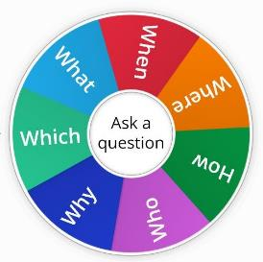
Collaborative Activities
Fostering Interpersonal Skills
Pair or Group Discussions
  Talk-partners (short discussion activities with question words what, why, how etc.)
#Speaking
“What is your favourite hobby?
“When did you first try it?
“Why do you like it?

Slide 37

Collaborative Activities
Fostering Interpersonal Skills
Pair or Group Discussions Variations…
  Fishbowl Debate
  Student Driven Discussion
  Two groups
  First Group in the middle (like a fishbowl) discusses
  Second Group observes/takes notes/assesses
  After end of discussion, the second group offers feedback: Strengths/weaknesses/proposals/opinion

Slide 38


Collaborative Activities
Fostering Interpersonal Skills
Pair or Group Writing Activity
  Snowballing
  Have each student write a sentence on a piece of paper
  Instruct them to crumple it and toss it in the middle
  The story will be continued by a different student
  Remember to increase time for reading after every exchange

Slide 39

Collaborative Activities
Fostering Interpersonal Skills
Task Sharing (sorting, matching, ranking)
  Encourages use of target vocabulary
  Making suggestions by using the language (justifying opinion, agreeing or presenting another viewpoint)
  Group vocabulary
    e.g. value of items, material etc.

Slide 40
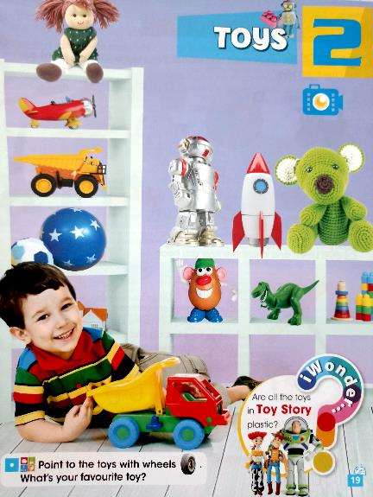
Collaborative Activities
Fostering Interpersonal Skills
Task Sharing (sorting, matching, ranking)
  Assign multiple tasks which will also ignite their critical thinking skills.
  Student1: “Point to the toys with wheels.”
  Student2: “Point to the toys made of plastic.”
  Have them cross check their findings.

Slide 41
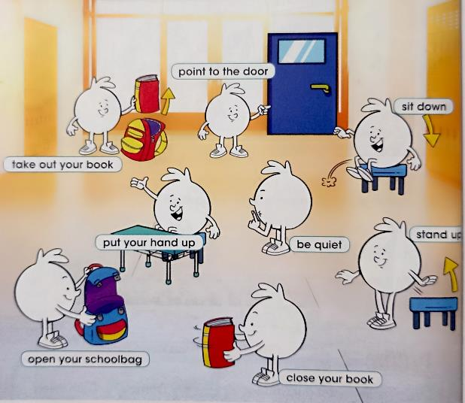
Collaborative Activities
Fostering Interpersonal Skills
Multiskilled Exercise:
Listening, Speaking, Adaptation to Body Language
Exercise:
“Sing the Song and Mime the Action”
Coordination and Teamwork

Slide 42
Collaborative Activities
Fostering Interpersonal Skills
Verbal/Collaborative Games
1. Storytelling A→Z e.g.
Tell a story, each sentence of which starts with the next letter of the alphabet, starting with ‘A’.
“Anyone seen my keys?”, “Beside the phone.”

Slide 43
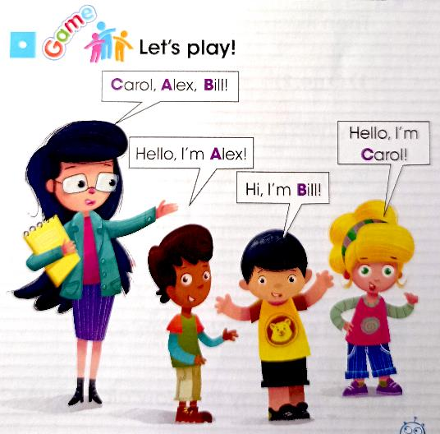
Collaborative Activities
Fostering Interpersonal Skills
Utilize Variations such as names or items.

Slide 44

Collaborative Activities
Fostering Interpersonal Skills
Verbal/Collaborative Games
1. Storytelling A→Z e.g.
Tell a story, each sentence of which starts with the next letter of the alphabet, starting with ‘A’.
“Anyone seen my keys?”, “Beside the phone.”
2. Name Ten in Ten
Choose a category and come up with 10 examples within 10 seconds e.g. makeup
Lipstick, blush, eyeliner, etc.

Slide 45
Collaborative Activities
Fostering Interpersonal Skills
Verbal/Collaborative Games
3. Fact or Fiction
Each student states two truths and one fictional claim about himself. The others must guess what is true.
4. Who Am I?
The student offers clues as to the person he or she is impersonating. (fictional or real)

Slide 46

Collaborative Activities
Fostering Interpersonal Skills
Drama and Theatre
  Rehearse a language
  Practice Intonation
  Proper Pronunciation
  Use in Speech or Writing

Slide 47



Collaborative Activities
Fostering Interpersonal Skills
Where can I find ELT Material for Theatrical Productions?
ELT Coursebooks contain a plethora of ideas and materials to utilize for your own play
Readers are easily adaptable

Slide 48

Collaborative Activities
Fostering Interpersonal Skills
Nursery Rhymes (read books, watch videos)
Even if they don’t understand the words, they will find it entertaining, show an eagerness to participate (via role play) and subconsciously learn proper pronunciation

Slide 49
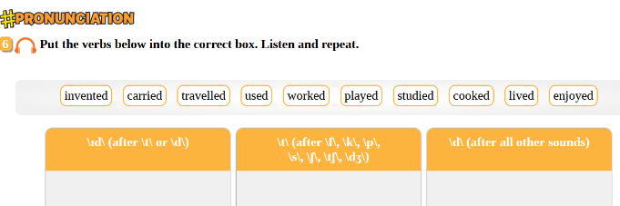

Collaborative Activities
Fostering Interpersonal Skills
Pronunciation and Intonation are CRUCIAL elements of Public Speaking and Communication
Drama and Theatre are Collaborations which promote these skills

Slide 50

Collaborative Activities
Fostering Interpersonal Skills
Intonation via Role Play
  e.g. “Did you clean your room?”
Use facial expressions!
Use the same sentence with various emotions!

Slide 51


Sentence Stress
EXAMPLE
Have students read aloud various lines in different ways
Let them experiment with different emotions
Act it out!
  Word Stress, Sentence Stress, Intonation
  Excited and Amazed at the result

Slide 52


Sentence Stress
EXAMPLE
The way we stress a sentence can change its meaning
e.g. “I didn’t say he stole the money.”
I didn’t say he stole the money.
I didn’t say he stole the money.
I didn’t say he stole the money.
I didn’t say he stole the money.
I didn’t say he stole the money.
I didn’t say he stole the money.
I didn’t say he stole the money.

Slide 53

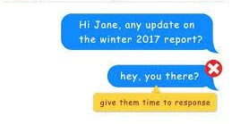
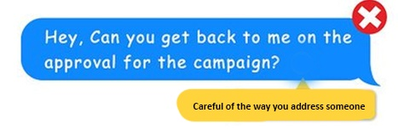
Media and Information Literacy
Careful of where and how we communicate!
  Choosing the right platforms for communication (with font format variations e.g. ‘italics’)
  Properly addressing the other

Slide 54


Media and Information Literacy
Credibility of sources
Information pages are a wonderful tool but they ARE NOT always credible
Exercise proper research to validate and verify claims

Slide 55
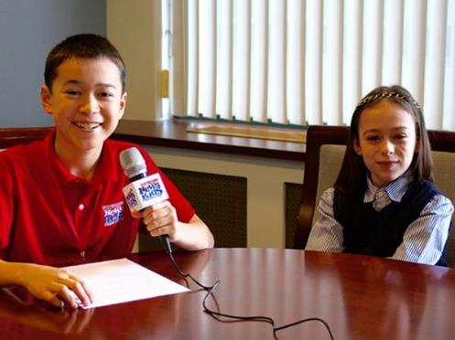
Collaborative Activities
Fostering Interpersonal Skills
Information Exchange
  Journalism & Role Play
  Practice Note Taking
  Writing an article
  Requires written preparation
  Fosters responsibility

Slide 56
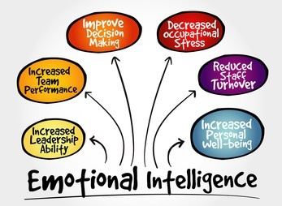
Well-being and Self Confidence
Intrapersonal Skills – Emotional Intelligence
What is Emotional Intelligence?
  Self-Awareness
  Self-Regulation
  Motivation
  Empathy
  Social (PR) Skills

Slide 57

Establishing the Teacher – Student Relationship
Well-being and Self Confidence
Intrapersonal Skills – Emotional Intelligence
Get to know your students
Family Background
Special Educational Needs
Relationship with classmates
Personal Interests

Slide 58
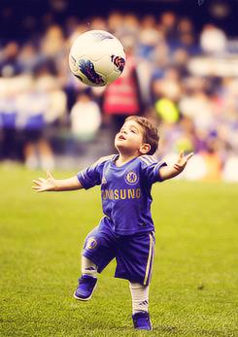
Do Your Research
Well-being and Self Confidence
Intrapersonal Skills – Emotional Intelligence
Ask Them…
What are their hobbies?
Do they play sports?
Which athlete do they look up to?
What are their favourite celebrities?
What kind of music do they listen to?

Slide 59
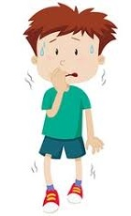
Instilling Respect & Cooperation
The Student-Student Relationship
A student will NOT participate and in most cases be terrified, if he thinks he will be teased or even bullied in class.
Shyness, fear of criticism

Slide 60

Instilling Respect & Cooperation
The Student-Student Relationship
A student must feel SAFE, CONFIDENT and HAPPY when attending his classes.
Promotion of Inclusiveness, Teamwork

Slide 61

Well-being and Self Confidence
Encouraging Participation
1. Praise your student’s efforts, even if he makes mistakes
2. Students should encourage each other

Slide 62

Well-being and Self Confidence
Speaking Using the Correct Grammar and Syntax
Correct your students AFTER they have finished speaking.
If they are corrected while speaking, they LOSE FOCUS or PANIC or WANT TO GIVE UP!
e.g. “The girl she is wearing a wonderful pink dress. She is walking in the forest and looks happy.

Slide 63
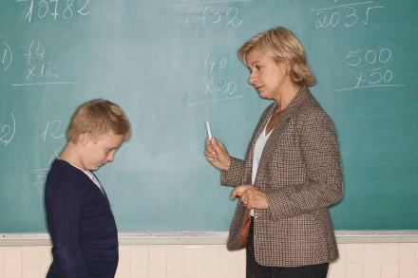
Well-being and Self Confidence
What about disrespectful students?
SET the Rules in Class!
Make it perfectly clear to everyone that ONLY the teacher will be correcting students during the lesson.

Slide 64

Respecting Students with SEN’s
Lesson needs to be tailored to their needs
  time
  elements examined
  marking
It’s our OBLIGATION as teachers to make sure our students are offered equal opportunity to perform and shine.

Slide 65

Fostering Global Ties
Promoting Global Citizenship
Children are not born racist
Diversity, inclusiveness, gender equality and respect are values they are obliged to adopt
How can we achieve this?
Education!
Exposure to cultures, traditions, viewpoints
Learning a ‘foreign’ language is the key to an inclusive society

Slide 66

Benefits of Adopting Transversal Competencies
Helps to Improve Decision Making
It enhances Problem Solving
Refines Research Skills
Polishes Creativity
Stimulates Curiosity

Slide 67

Benefits of Adopting Transversal Competencies
The Fostering of a Lifetime Skill
Key to Career Success
Broad range of Cognitive Learnings
Improves Relationships
Enhances Creativity

Slide 68

As Teachers, it’s our obligation and duty to prepare the generations of the future… our children
THIS is our legacy

Slide 69

References
  Moore, T. (2013). Critical thinking: seven definitions in search of a concept. Studies in Higher Education, 38(4), 506-522.
  Case, R. (2013). The Unfortunate Consequences of Bloom’s Taxonomy. Social Education, 77(4), 196-200.
  Van Gelder, T. (2005). Teaching critical thinking: Some lessons from cognitive science. College teaching, 53(1), 41-48.
  Mulnix, J. W. (2012). Thinking critically about critical thinking. Educational Philosophy and Theory, 44(5), 464-479.
Wong, B. L. (2016). Using Critical-Thinking Strategies To Develop Academic Reading Skills Among Saudi Iep Students.
EFL Magazine, https://eflmagazine.com/critical-thinking-english-language-teaching
https://tscfm.org/blogs/the-benefits-of-critical-thinking-for-students/
https://busyteacher.org/17541-8-critical-thinking-activities-esl-students.html
www.unicef.org/education, https://mylearningtolearn.com/transversal-skills/

Slide 70
References
  https://www.bell-foundation.org.uk/eal-programme/guidance/effective-teaching-of-eal-learners/great-ideas/collaborative-activities/
  https://www.valamis.com/hub/collaborative-learning
  https://familiesforlife.sg/play-as-a-family/Pages/Conversation-Games-With-Kids.aspx
  https://www.researchgate.net/publication/319107073_Psychological_Problems_and_Challenge_In_EFL_Speaking_Classroom
  https://www.researchgate.net/publication/351346714_The_Effect_of_Psychological_Factors_on_English_Speaking_Performance_of_Students_Enrolled_in_Postgraduate_English_Language_Teaching
  The Effect of Psychological Factors on English Speaking Performance of Students
  https://www.glrjournal.com/jadmin/Auther/31rvIolA2LALJouq9hkR/QHF9jISH8U.pdf
  https://youtu.be/JVCFGLVZA3w
  60-Second Strategy: Fishbowl Discussion

Slide 71






Thank you!!!
Sources: “iWonder” & “#Hashtag English”
Email: katherinereilly@expresspublishing.co.uk
Support: +30 210 212 0800
PowerPoint Presentation Available at: katherinereilly.blog

