Slide 1

Writing for Exam Takers
Plenary Speaker:
Katherine Reilly
Author & Educator
katherinereilly.blog

Slide 2

What is this Presentation about?

Slide 3

Focal Points of this Presentation
Proper Approach to Writing in Exams
Writing Tasks Criteria
Writing Tasks Analysis – C2 Level

Slide 4

When will they be Ready to Write?
Basic Grammar and Limited Vocabulary
Still have a few years till their exams.
START WRITING! Don’t wait for them to achieve the perfect command of the language.
Progress, Not Refinement

Slide 5
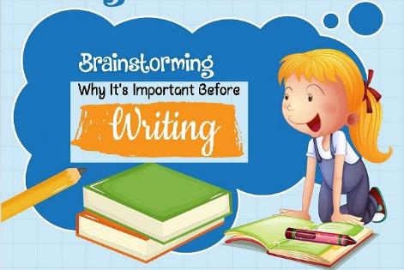
Assessment of Task BEFORE
Grabbing a Pen
Comprehension of Writing Format (Letter, Essay, Article etc.)
Structure
  Paragraphs and Content of each
  Topic Sentences
  Thesis Statement
  Examples/Evidence
  Vocabulary Range
  Greeting/Closing/Title/Headings

Slide 6

Committing Oneself to the Task
Make certain the task is clearly understood
Evaluate the potential for sharing personal experience or knowledge of the task
Correctly decipher the source material
Adhere to one’s opinion (avoid contradicting thoughts)

Slide 7

What do we Examiners Focus On?
Completing a Task
Development
Language Use
Originality and Engagement

Slide 8
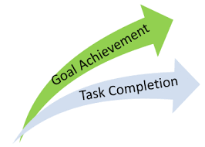
1. Completing a Task
Topic Relevance (on/off topic)
Multiple viewpoints
Candidate’s Opinion
Source Embedment

Slide 9

2. Development
Meticulous analysis of claims
Organizational Skills
Appropriate Structure
Cohesion and Flow

Slide 10
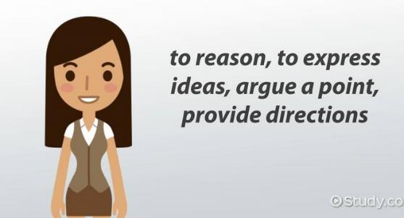
3. Language Use
Grammatical Efficiency
Vocabulary Range & Usage
Rhetorical Questions
Variety of Grammatical Structures are encouraged
Formulaic Writing

Slide 11
What is Formulaic Writing?
Formulaic writing is essentially a shortcut that allows writers to generate interest without the hard work of writing engaging, informative and valuable content.
Source: zerys.com

Slide 12
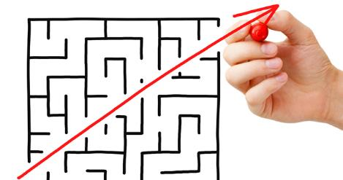
Formulaic Writing Advantages
Formulas provide scaffolds
They reduce cognitive load
Boosts self-esteem

Slide 13

Formulaic Writing Disadvantages
Strong writers may be frustrated
Confines students autonomy
Limits understanding of what writing is
There is already so much repetitive and duplicable content out there!

Slide 14

Use a blend of Formulaic Writing!
Get more specific by using statistics, case studies, interviews and testimonials
Don’t just offer generic advice
Offer a fresh perspective

Slide 15

Careful of Formulaic Writing!
Formulaic expressions MUST fit the context of their response
There are often too many, rendering them inappropriate to the context
They MUSTN’T be too general or lack originality
Negative Impact on their rating

Slide 16

4. Originality and Engagement
Originality
  (personal examples, original ideas – thinking outside the box)
Reader Engagement
  Devices e.g. Rhetorical questions
  Heightened sense of awareness of the audience
  Not one specific approach
  Creativity, freedom, experimentation

Slide 17

Proofreading
Go through the writing again
Focus on Grammar and Syntax
Substitute poor vocabulary with more advanced terms
Rectify repetitive vocabulary
Go through it once more to make sure it makes sense (e.g. misuse of vocabulary, language structures etc.)
Cohesion???

Slide 18
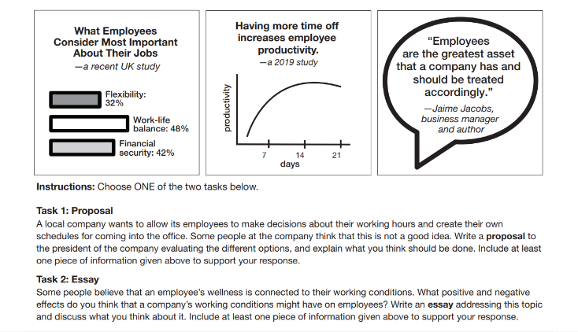
Proposals
Example – ECPE Sample Prompt 3

Slide 19

Proposals
So… What is a Proposal?
It’s written for a specific person of authority (company president, the mayor, a school principal)
State the purpose of writing in the introduction (e.g. examining a decision, plan or suggestion)
Presents opposing views of a decision/plan in the main body
Formal Language
Writer’s recommendation in conclusion
Headings for each paragraph are OPTIONAL

Slide 20

Proposals
Basic Model Outline
Addressing the recipient
To: The President To: The Mayor To: The School Principal
Introduction
State the purpose of writing
Main Body
Paragraph1: Present one view of the decision/plan
Paragraph2: Present the opposing view of the decision/plan
Conclusion:
Make your recommendations

Slide 21
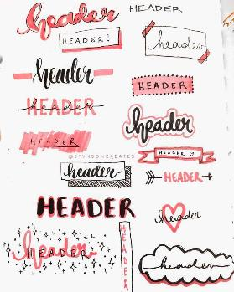

Proposals
What about the Headings?
To:
Introduction
Positive Response
Negative Response
Recommendation
To:
Introduction
Causes and Effects
Recommendations
Conclusion

Slide 22
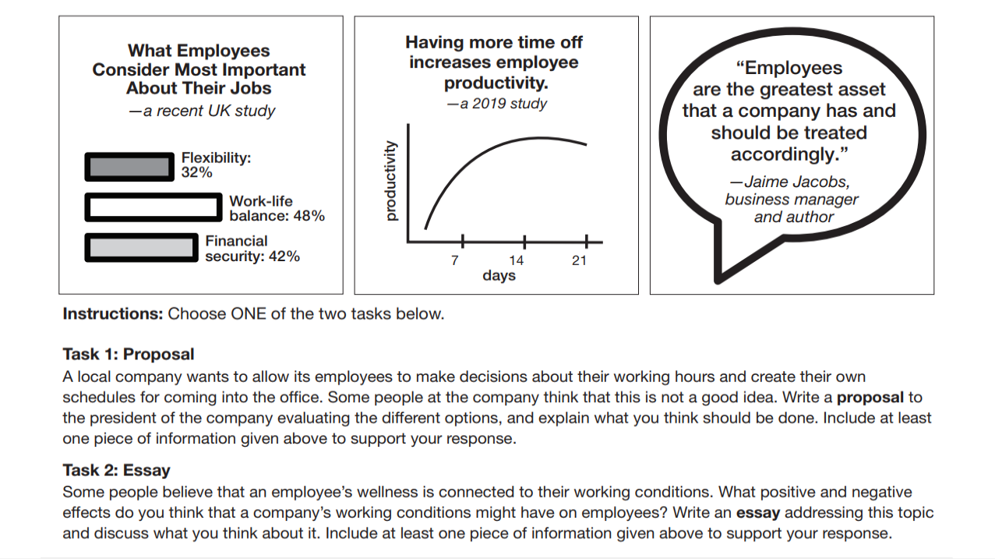


Slide 23
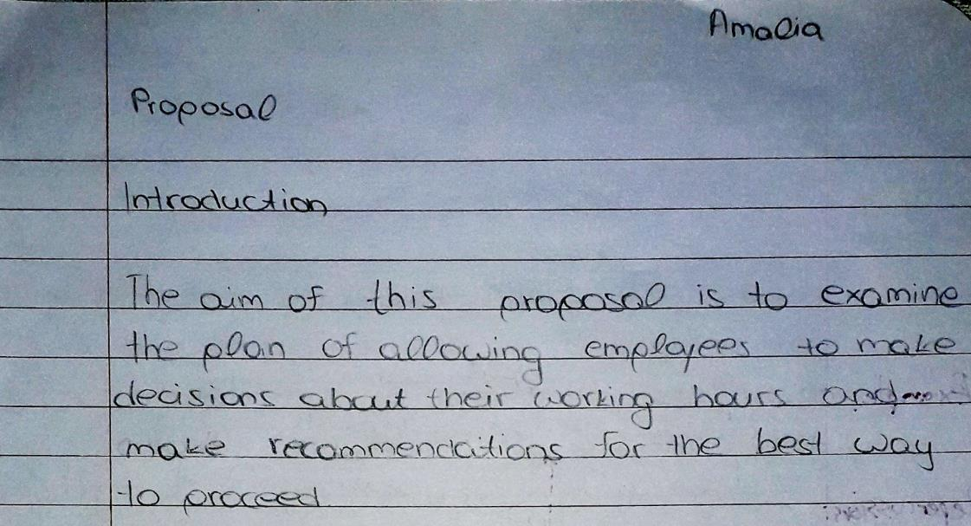

Slide 24
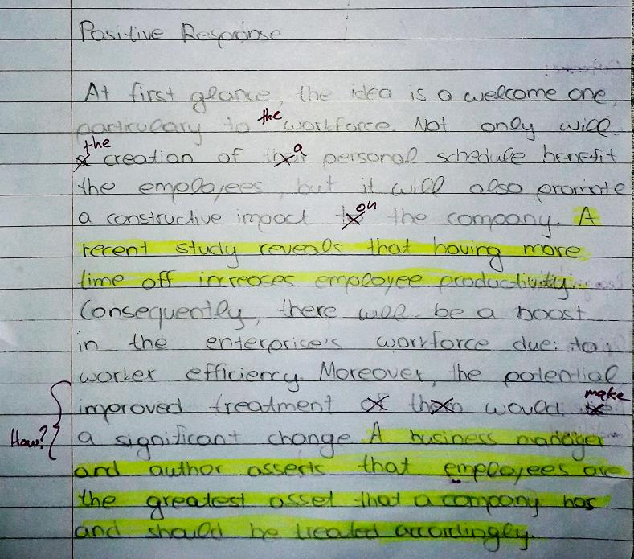

Slide 25
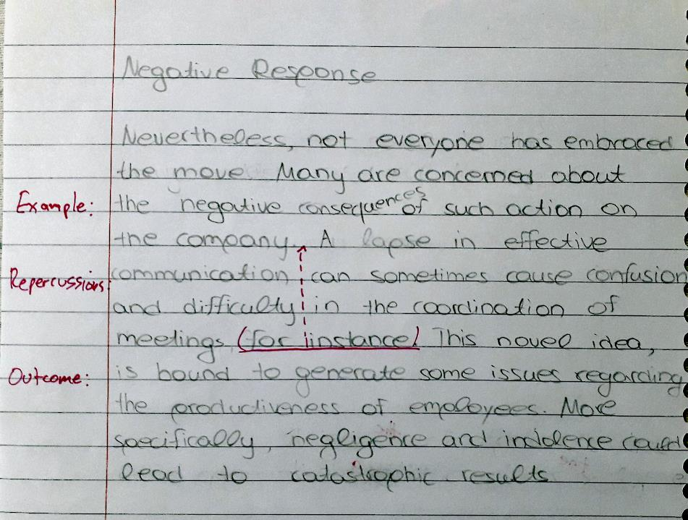

Slide 26
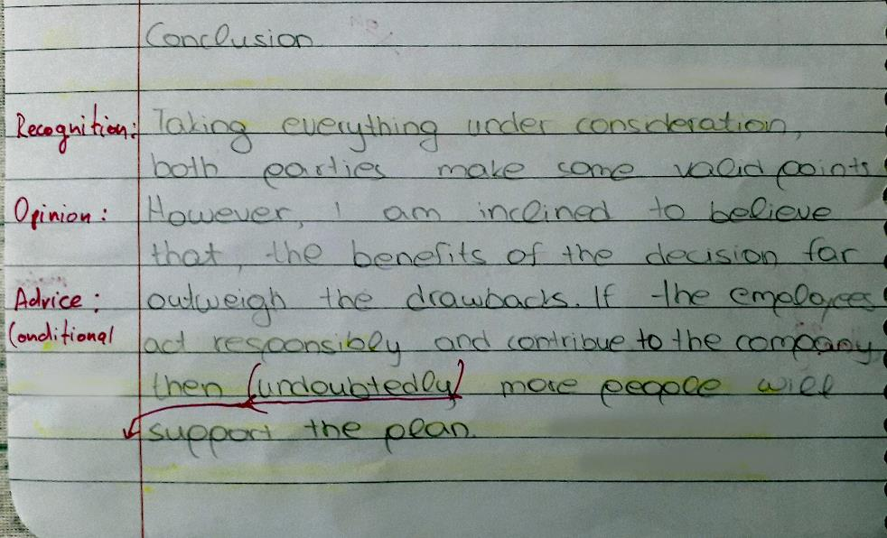

Slide 27
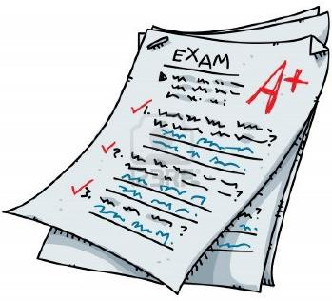
Correction and Marking
5
4
5
2
16/20
1-5 Task Completion
1-5 Development
1-7 Language
1-3 Authorial Voice
Maximum total 20 points
Total score x5
16x5=80%

Slide 28
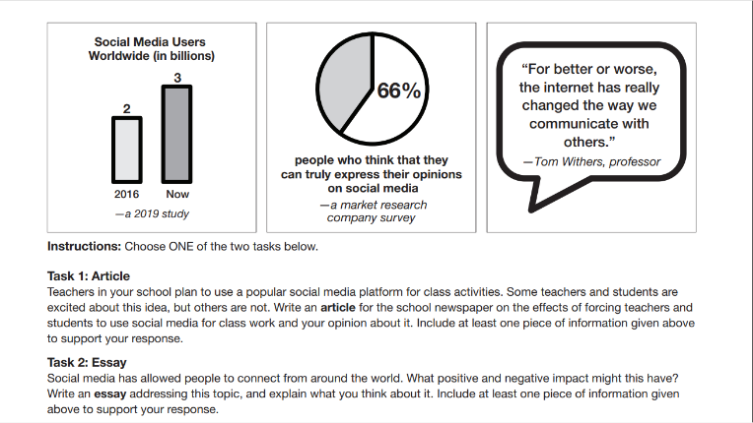
Articles
Example – ECPE Sample Prompt 1

Slide 29

Articles
So… What is an Article?
It’s written with the purpose of being published in a newspaper, a blog, a magazine etc.
Briefly describes a decision or plan in the introduction while also presenting the opposing views
Presents opposing views of a decision/plan in the main body
Formal Language
Writer’s recommendation or opinion in conclusion
Incorporates a brief title (expressing the main idea) which is OPTIONAL

Slide 30

Articles
Basic Model Outline
Title (Optional)
Title must express the main idea of the article
Introduction
Briefly describe the decision or plan
Briefly refer to the opposing views
Main Body
Paragraph1: Present one view of the decision/plan
Paragraph2: Present the opposing view of the decision/plan
Conclusion:
Express your opinion and/or make your recommendations

Slide 31
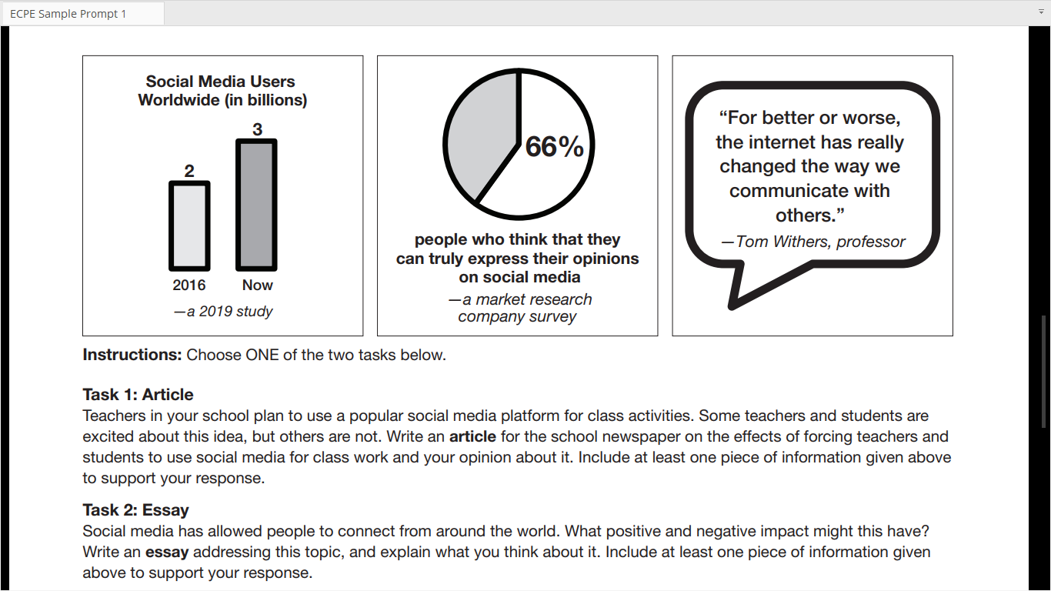

Slide 32
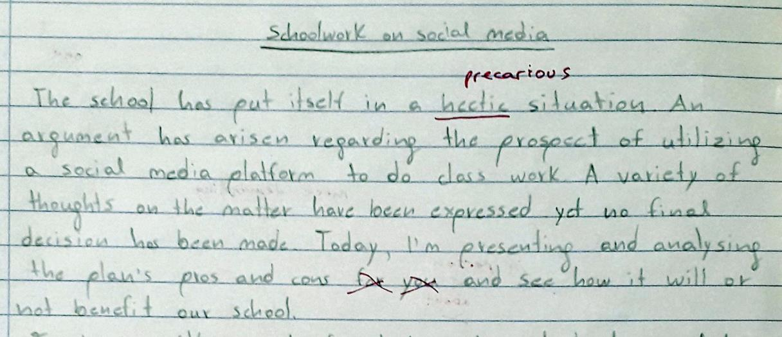

Slide 33
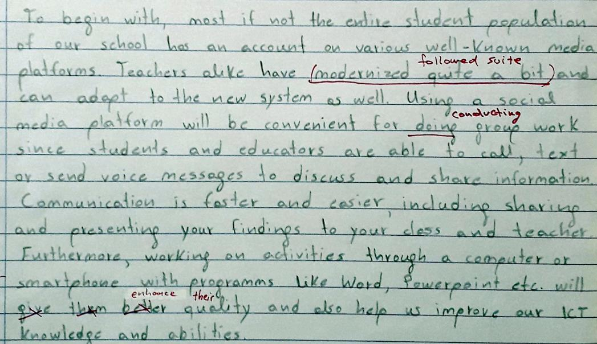

Slide 34
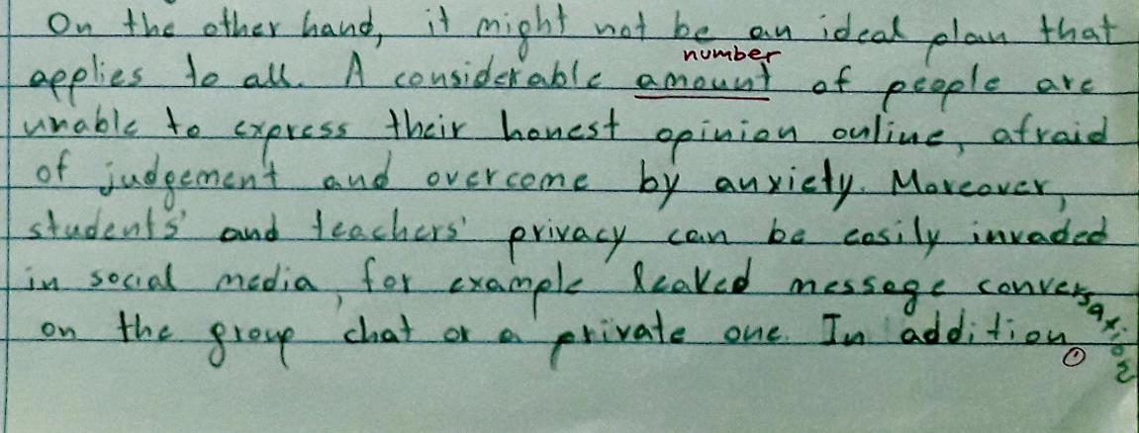

Slide 35
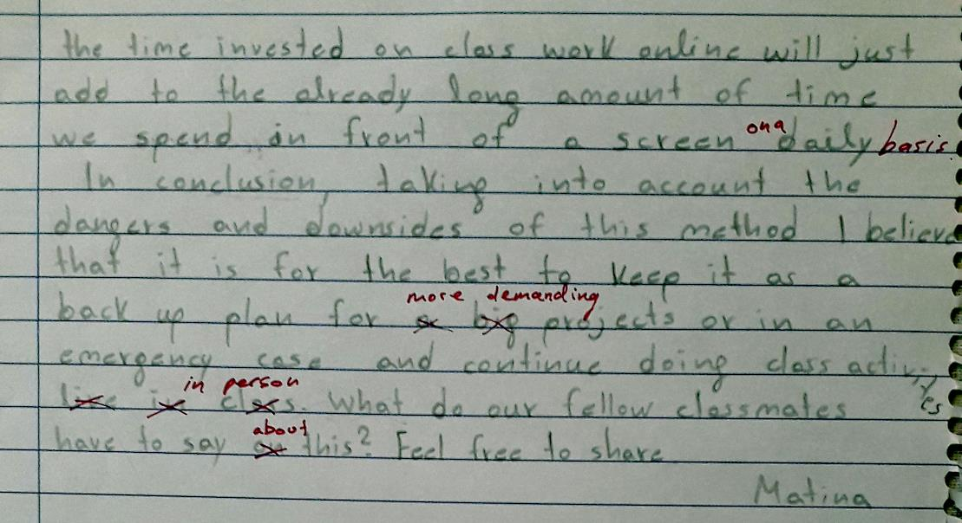

Slide 36
Correction and Marking
1-5 Task Completion
1-5 Development
1-7 Language
1-3 Authorial Voice
Maximum total 20 points
3
4
4
2
13/20
Total score x5
13x5=65%

Slide 37





Thank you!!!
Find me at:
katherinereilly.blog
Email: katherinereilly1@yahoo.com
Find FLF at:
eltnews.gr flforum.gr
Email: info@eltnews.gr
Support: +30 210 67 12 991
Sources: zerys.com
“The Art of Writing” – Express Publishing

