Slide 1

Speaking for Exam Takers
Plenary Speaker:
Katherine Reilly
Author & Oral Examiner

Slide 2

Focal Points of this Presentation
1. The Diversity of Oral Exams
2. Improving Oral Communication Skills
3. Speaking Test Analysis - B2 Level

Slide 3

The Diversity of Oral Exams
Some advice…
Both Educators and Students must be fully aware of the format and the key criteria
Consult Practice Test books
Contact Exam Provider
Attend Seminars/Webinars

Slide 4
The Diversity of Oral Exams
Multiple Universities and Colleges
Multiple Levels
Variety of Test Formats
Marking criteria varies
Single or Pair Test Taking

Slide 5
The Diversity of Oral Exams
Multitude of Tasks
  Monologue/Dialogue
  Description of a photo
  Description of an event
  Problem Solving
  Expressing Preference
  Role Play
  Supporting an argument

Slide 6
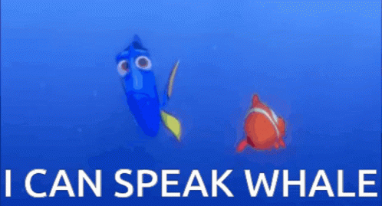
Qualities of Spoken Language
Grammatical Range & Accuracy
The ability to use a wide range of structures
Production of error-free sentences with only occasional inappropriacies or basic nonsystematic errors
Level of Range & Accuracy reflects exam level

Slide 7
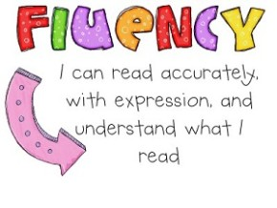
Qualities of Spoken Language
Fluency & Coherence
Speaks fluently with occasional repetition or self-correction
Hesitation is usually content-related and only rarely to search for language
Develops topics coherently and appropriately
Level of Fluency and Coherence reflects exam level

Slide 8
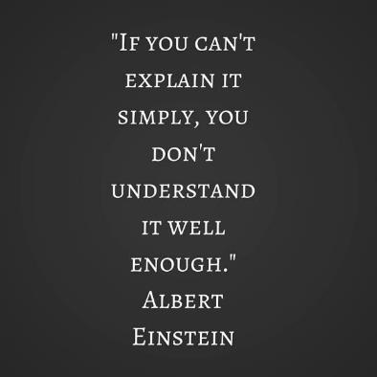
Qualities of Spoken Language
Comprehension
The ability to convey ideas clearly
Proper use of vocabulary and lexical structures
Potential to sustain a conversation

Slide 9

Qualities of Spoken Language
Pronunciation
Effectiveness of sounds
Accuracy of Pronunciation
Expressiveness

Slide 10
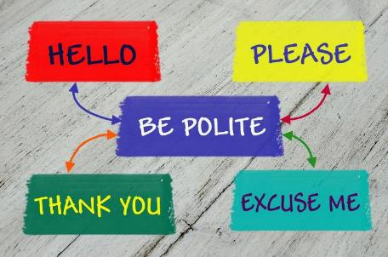
Qualities of Spoken Language
Sociolinguistic Appropriateness
Appropriateness of Language
Body Language - Gestures
Politeness and Formality
Intonation Patterns for Pragmatic Effect

Slide 11
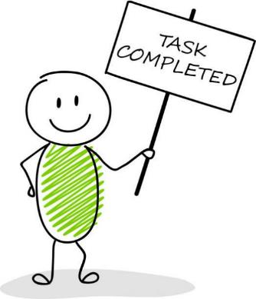
Qualities of Spoken Language
Task Completion
Topic nomination, maintenance and termination
Relevance to topic (on/off topic)
Detailed expansion of task

Slide 12
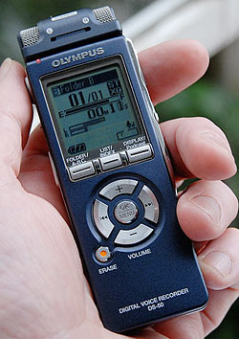
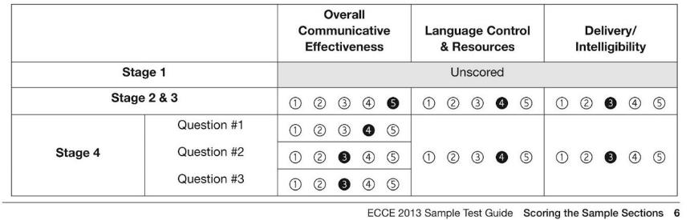
Assessing Candidates
Recording the Interview
How many Examiners?
Interlocutors and Assessors?
Evaluators?

Slide 13

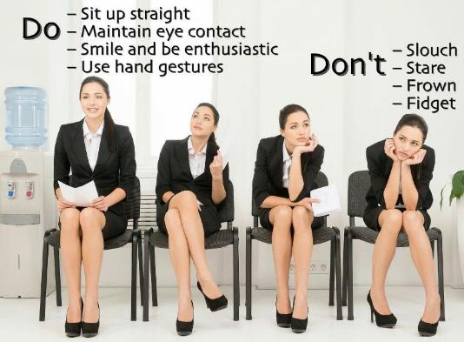
Body Language
Body Posture
Body gestures are aspects of communication
Exudes confidence
Reinforcement of ideas
Chewing Gum
Eye contact – sign of respect
Hand gestures

Slide 14

Pausing and Hesitating
Pauses are accepted to allow test taker to evaluate
Many tests allow specific time for this
Extended time in many cases is not allowed
During speech, a few instances of pausing are allowed
Fluency and intelligibility suffer when speech pattern is inconsistent

Slide 15
Pausing and Hesitating
Kindly request for some more time to compensate
Don’t overdo it though
PLEASE respect the time given, otherwise mark will be affected
DON’T insist to continue if examiner tells you to stop

Slide 16

Clarification
Didn’t hear clearly (ask the examiner to repeat)
Didn’t understand (ask the examiner to rephrase)
Unknown word(s) – explanation allowed?
Still can’t understand - panic ensuing?
  Examiners are trained to deal with this

Slide 17

Memorization and Rehearsed Answers
The Examiner is assessing your ability to communicate – NOT RECITE
Automated responses are unnatural
They can’t be used everywhere
Rote Learning the answers from students who have already taken the test
Memorized Personal Presentation for Stage 1

Slide 18

Memorization and Rehearsed Answers
Some expressions are of course welcome
  “Just give me a second”
  “I tend to believe that”
  “I prefer the first picture because”
Formulaic Expressions are a part of every language
  “Thank you!”
  “Nice to meet you”
  “May I come in?”

Slide 19

Reaching Conclusions
A “conclusion”, a “decision” is the culmination of a natural conversation
Memorization DOES NOT allow the candidate to finalize the conversation
Lack of Critical Thought hinders such an objective
A conclusion is to be drawn after exchanges of ideas and thoughts
The examiner is trained to lead the conversation to it within a time limit

Slide 20

Having a Conversation
What is a Conversation?
Dialogue NOT Monologue
With the Examiner or another Candidate
Sustaining a Monologue will diminish mark in specific category
It’s disrespectful towards the other
Counterproductive

Slide 21
Having a Conversation
Unable to understand the other?
  “could you please repeat that?”
  “I didn’t quite catch that”
  “what exactly do you mean?”
  “can you further elaborate?”
  “I kind of lost you there”
  “so you’re saying that…”

Slide 22
Having a Conversation
Commenting – even interrupting politely – are elements which are examined and marked
  “excuse me…”
  “may I add something?”
  “I see your point”
  “wouldn’t it be better though if…”
  “you do have a point”
  “I apologize, but I tend to disagree”

Slide 23
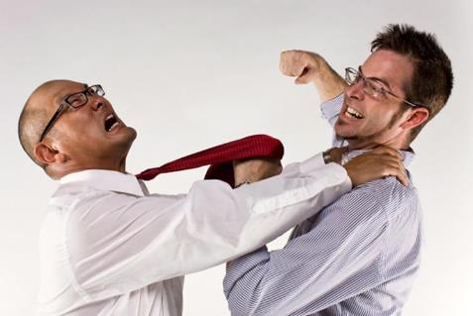
Disagreeing Politely (NOT Condemning)
How not to seem cruel or egotistic
  “I understand your concerns, however,”
  “Great idea but how about”
  “I appreciate you giving it some thought but we should also consider”
  “Sounds interesting but what if we”

Slide 24
Conversation Etiquette
When speaking, don’t turn it into a monologue
Speaking longer DOES NOT MEAN you’ll get extra points
In some cases you lose points
If for any reason your partner doesn’t stop, raise your hand gently and look at your partner or examiner)

Slide 25
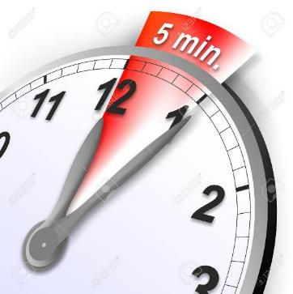
Time Limits
Each test has different restrictions
Under the time limit
  Examiner urges candidate to continue
  Nothing left to say? Be Honest!
Surpassing it
  Insistence on continuing
    PLEASE DON’T!
    Delays
    Negative Mark

Slide 26

Classifying Oral Skills – What to Practice
Repertoire of Routines:
Exchanging Information
  Providing Personal Information
  Give Instructions
  Offer Directions
  Narrate a Story
  Describe Something-Someone
Based on Weir (1993)

Slide 27

Classifying Oral Skills – What to Practice
Providing Personal Information
Name, age
Family members
Neighborhood
Hobbies
Aspirations
Boosts self-esteem
Promotes a positive image

Slide 28




Classifying Oral Skills – What to Practice
Giving Instructions
Recipe
How to play a game
Magic Tricks
How to take care of a pet

Slide 29

Classifying Oral Skills – What to Practice
Too childish? I have proficiency students!
Just remember…
There are also very young test takers
Communication starts at primary levels
Games can (and should) be used in advanced levels
Bargaining, proposing, interacting

Slide 30
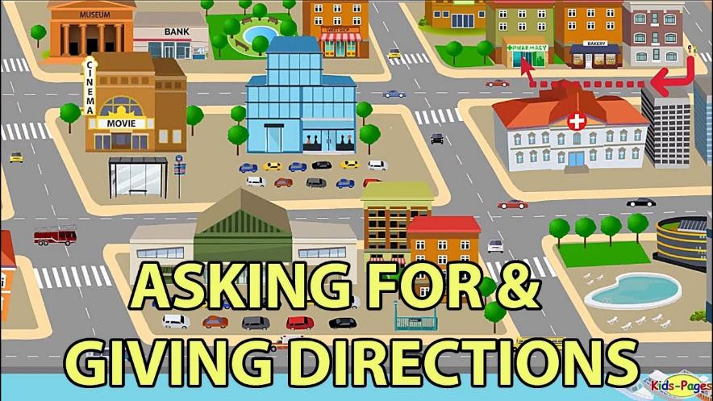
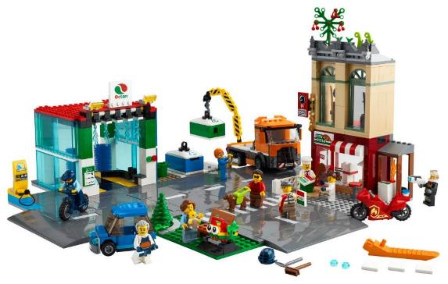
Classifying Oral Skills – What to Practice

Slide 31
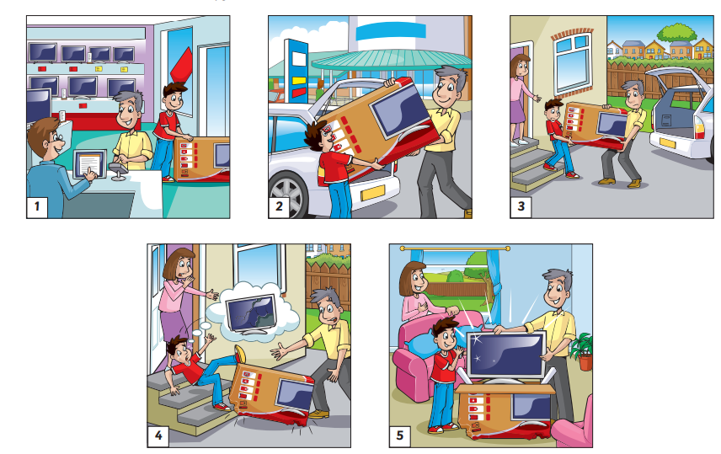
Classifying Oral Skills – What to Practice
Narrating a Story
Practice techniques in story telling
Expressing emotions while narrating
Role play can also be implemented

Slide 32

Classifying Oral Skills – What to Practice
Retelling a Story
Listen to a story, news bulletin, interview
Ask students to retell it
At the end, ask them to express how they felt about it
Ask other students to follow suite

Slide 33

Classifying Oral Skills – What to Practice
Describing Something
Object (Show and Tell)
Store
Monument
Painting
Museum
Focus on feelings too (not only physical attributes)

Slide 34
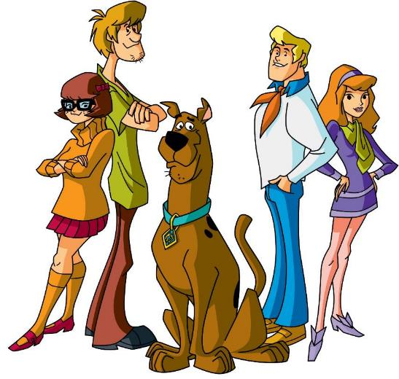
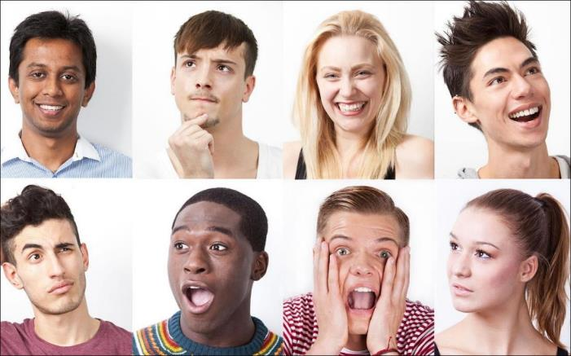
Classifying Oral Skills – What to Practice
Describing Someone

Slide 35

Classifying Oral Skills – What to Practice
Repertoire of Routines:
Interacting
  Telephoning
  Buying or Selling
  Requests
  Role-Play Interviews
  Expressing Opinions
  Making Suggestions
Based on Weir (1993)

Slide 36

Oral Mock Tests
Record their oral mock test
Have them hear it afterwards
Share feedback with them
Focus on elements which need attention
Offer recommendations for enhancement
During first test, it’s okay to interrupt and offer guidelines as regards its format

Slide 37
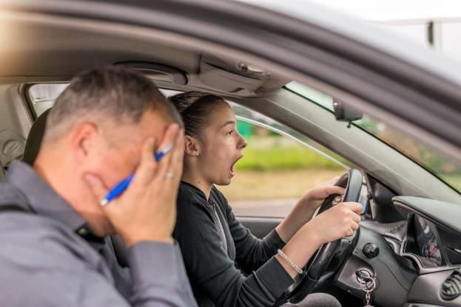
Helping stressful students
Explain to students that stress is inevitable in ALL types of tests
Even examiners are stressed so it’s okay
We ALL make mistakes EVERY DAY
Examiners are people like everyone else
Many of them are also teachers 😉

Slide 38

Helping stressful students
Practically speaking…
  Messing up one part isn’t the end of the world
  The final score is a culmination of over a dozen factors
  The first impression we get of our performance is the one we should bear in mind. Self-doubt kicks in after we leave the exam room

Slide 39

Helping stressful students
Practically speaking…
  Examiners can’t tell you if you’ve passed or not – please don’t ask us
  Don’t make assumptions of your mark by judging our facial expressions. WE’RE TIRED!

Slide 40

Students with SEN’s
The test is tailored to their needs
  time
  elements examined
  marking
Contact exam centre for details and guidelines
It’s our OBLIGATION as teachers to make sure our students are offered equal opportunity to perform and shine.

Slide 41
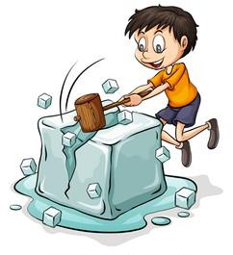
Oral Exam B2 Level Student
Breaking the Ice
The first stage is not assessed by most exams.
Its purpose is to help the examinee get acquainted with the examiner and relax.
Watch Video

Slide 42

Oral Exam B2 Level Student
Supporting an argument
Is it better to socialize on the Internet or go out and make friends?
The candidate is in favor of going out to make friends
Watch Video

Slide 43
Oral Exam B2 Level Student
Supporting an argument
Is it better to socialize on the Internet or go out and make friends?
The candidate is in favor of going out to make friends
He has no claims to support his argument
“Face to Face is better”
“Internet is good for the communication”
Task goal has not been achieved
Language use is poor e.g. have-has
Linguistic Appropriateness “this”

Slide 44

Oral Exam B2 Level Student
Describing Pictures and Selecting One for a Purpose
Watch Video
First picture was described with basic vocabulary and a few mistakes
Second picture had inadequate description
His choice was underdeveloped “It’s the best choice and interesting”

Slide 45

Oral Exam B2 Level Student
Role Play
Watch Video
Despite grammar and lexical inaccuracies, he expressed his opinion
The conversation was sustained and included minor details – He wanted to stay near the Eiffel Tower
Despite these issues, he did have a comprehensive conversation

Slide 46





Thank you!!!
Find us at:
eltnews.gr flforum.gr
Email: info@eltnews.gr
Support: +30 210 67 12 991

